Slide 1
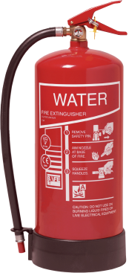
Fire
Extinguishers, Personal Protection Equipment (PPE)
& Safety Signs

Slide 2
What Makes a Fire ?
The Fire Triangle
Heat
Oxygen
Fuel
Notes:
Fire just does not happen. There are 3 elements that must be present for a fire to burn; heat, Fuel and Oxygen.
All 3 are needed for a fire, so if you take one away the fire will not burn.
Oxygen is almost always present as we need it to breathe. Therefore we only have control over 2 elements. The rule is to never mix fuel and heat.

Slide 3
Fire Extinguishers
A fire extinguisher is an active fire protection device used to extinguish or control small fires, often in emergency situations. It is not intended for use on an out-of-control fire, such as one which has reached the ceiling, or otherwise requires the expertise of a fire department. Typically.
a fire extinguisher consists of a hand-held cylindrical pressure vessel containing an agent which can be discharged to extinguish a fire.

Slide 4
When you hear the fire alarm:
Leave at once, taking direction from the emergency warden.
Do not delay yourself by gathering personal items. Your safety always comes first.
Before you open any door, feel the door with the back of your hand. If the door is cold, slowly open it.
If there is no smoke in hallways or stairwells, follow your building’s evacuation plan. Get out quickly using designated fire exits.

Slide 5
When you hear the fire alarm (continued):
Close doors behind you, however do NOT lock the door. Locking the door hinders the fire department’s search.
The stairway will be your primary escape route. Never, never use elevators under any circumstances.
Once in the stairway, proceed down to the first floor and out of the building. Never go up.

Slide 6
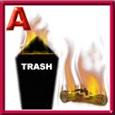
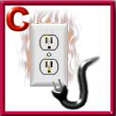
Multi-Class Ratings
Many extinguishers available today can be used on different types of fires and will be labeled with more than one designator, e.g. A-B, B-C, or A-B-C.
(A) This label shows that this extinguisher can be used on ordinary combustibles (B)flammable liquids.
The red slash through the last symbol tells you that the extinguisher cannot be used on electrical fires
(C) electrical fires.
New Style of Labeling
Be advised that most fire extinguishers will function for less than 40 seconds.
Old Style of Labeling

Slide 7
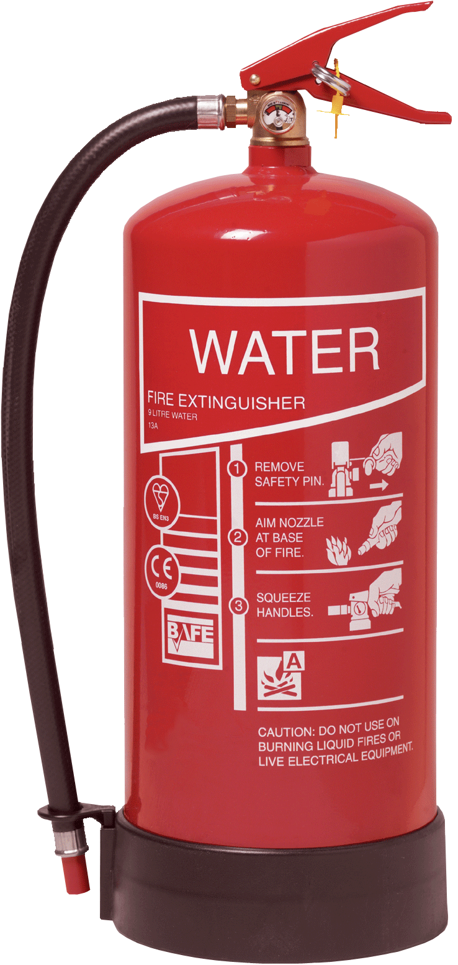
Type of extinguishers 1.Water extinguishers
Red body
Suitable for wood fires, furniture and paper etc.
Not Oil, Petrol, cooking fats etc.
Not safe to use on fires involving electricity;
Extinguishes by cooling

Slide 8
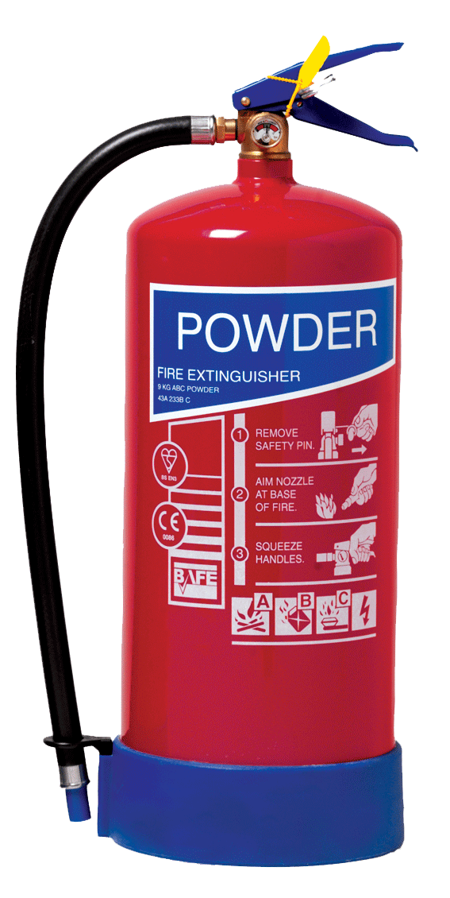
Powder extinguishers
Red body with blue label.
Safe to use on any type of fire.
Works by chemically Interfering with the combustion reaction

Slide 9
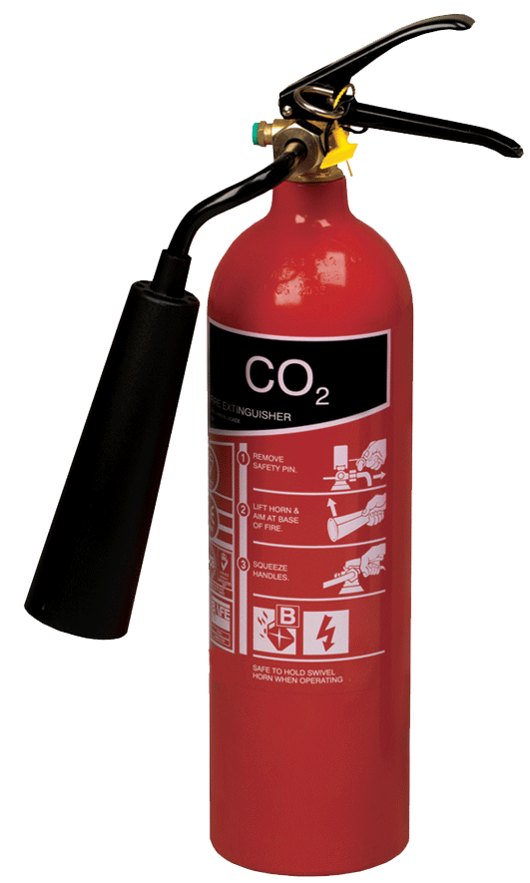
Carbon dioxide [CO₂] extinguishers
Red body with black label
Safe to use on any type of fire;
Safe to use on fires involving electricity;
Extinguishes by reducing oxygen levels and cooling.

Slide 10
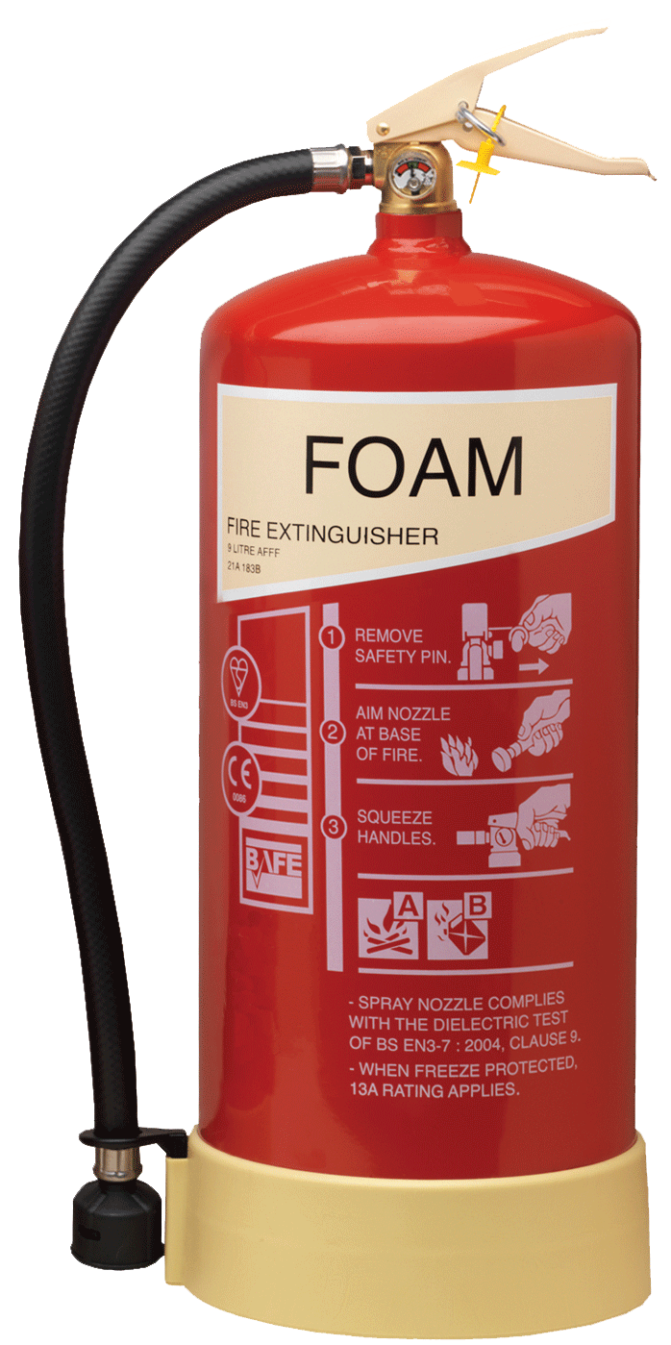
Foam extinguishers
Red Body with Cream label.
Suitable for Flammable liquids, petrol, solvents etc
Not suitable for use on fires
involving Electricity;
Extinguishes by cooling and sealing the surface of a burning liquid.

Slide 11
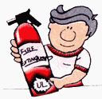
10 Tips on How and When to Use a Fire Extinguisher
1
Most fires start small. Except for explosions, fires can usually be brought under control if they are attacked correctly with the right type and size of extinguisher within the first 2 minutes!
2
A fire extinguisher should be "listed and labeled" by an independent testing laboratory. Make sure you can hold and operate the model you are using.

Slide 12
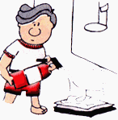
3
Before attempting to fight a small fire, be sure everyone is out of the area. Ensure someone has called the fire department.
If the fire starts to spread or threatens your escape path, get out immediately!
4
The operator must know how to use the extinguisher quickly without taking time to read directions during an emergency..

Slide 13
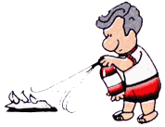
IF YOU FIGHT A FIRE, REMEMBER THE WORD P A S S
PULL . . . AIM . . . SQUEEZE . . . SWEEP
5
PULL... the pin. Some extinguishers require releasing a lock latchother motion.
6
AIM... low, pointing the extinguisher nozzle at the base of the fire.

Slide 14
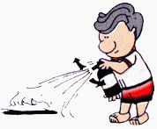
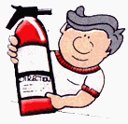
7
SQUEEZE... the handle. This releases the extinguishing agent.
8
SWEEP... from side to side at the base
of the fire until it appears to be out..

Slide 15
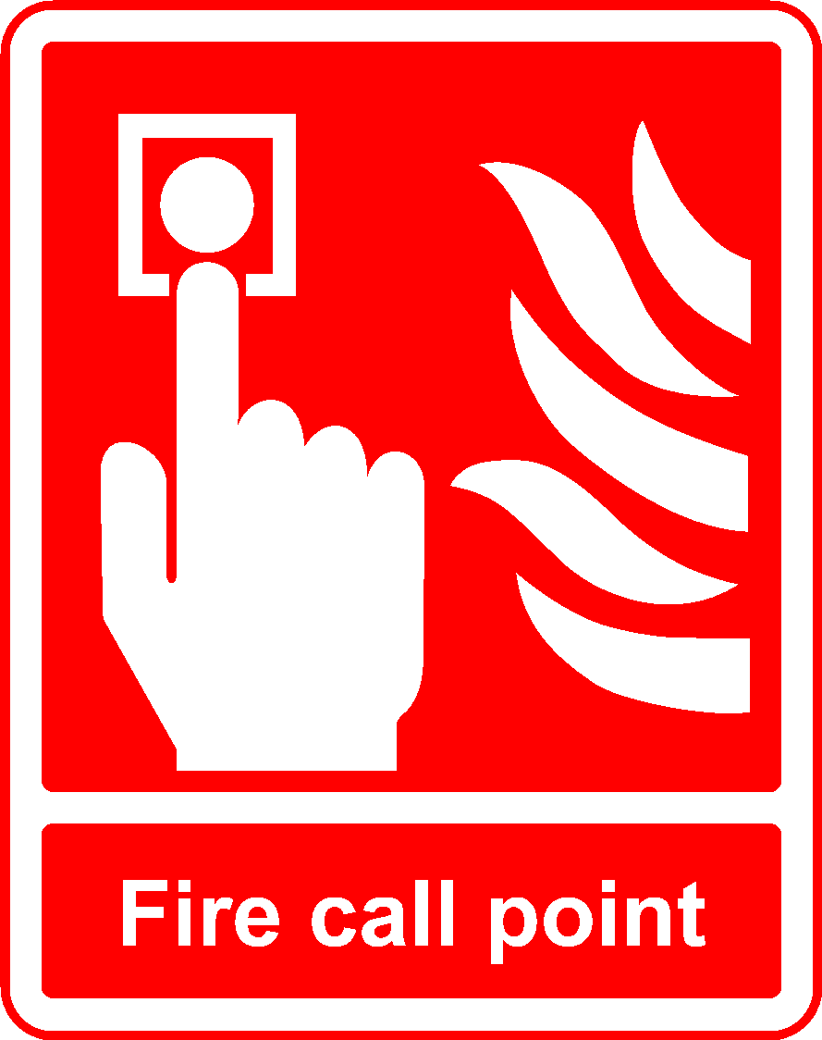
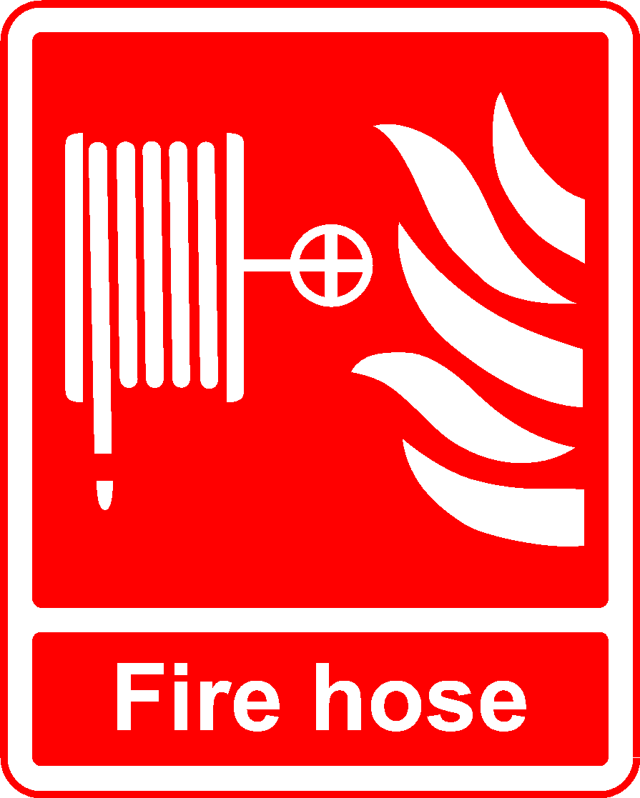
Other fire fighting equipment
Fire Safety Signs
PRESS HERE TO SOUND THE FIRE ALARM
FIRE HOSE REEL

Slide 16
Remember!
Your Safety Comes First
When in doubt, leave the fire fighting to the professionals

Slide 17
Safety Signs

Slide 18
Safety Signs
Blue/White = Must Do
Green/White = Safety Information
!
Red/White = Must NOT Do
Yellow/Black = Health & Safety Hazard Warning

Slide 19
Safety Signs
Any Red and White sign with a line through means:
“ Not Allowed or Must Not”
NO SMOKING

Slide 20
Safety Signs
Yellow + Black = HAZARD WARNING
FLAMMABLE SUBSTANCE
WARNING - LASER BEAMS

Slide 21
Safety Signs
BEWARE
ELECTRICITY
TOXIC
EXPLOSIVE

Slide 22
Safety Signs
Green + White = SAFETY Information
Safe Route to Fire Exit
First Aid Kit

Slide 23
Safety Signs
Blue + White = Mandatory or Must Do
YOU MUST WEAR OVERALLS
YOU MUST WEAR SAFETY GLOVES
YOU MUST WEAR EAR DEFENDERS

