Slide 1
Practical Clinical pharmacy Irritable Bowel Syndrome IBS Drugs in Practice
Prepared by Clinical pharmacist Israa Al-Mitwali

Slide 2
Irritable Bowel Syndrome IBS
Is a functional bowel disorder, there is no organic cause for IBS.
It is characterised by a range of symptoms, which may include abdominal pain, diarrhoea or constipation (or both alternately), abdominal distension and flatulence, together with non-intestinal symptoms such as headache and fatigue.
Symptoms are often exacerbated by stress, anxiety or depression.
As the cause cannot be determined, treatment is symptomatic.

Slide 3
Aggravating factors
Gastroenteritis
Stress
Anxiety`
Depression
Food intolerances
Caffeine some sweeteners i.e sorbitol and fructose
Other foods like: milk (there is no evidence of lactase deficiency in IBS) and dairy products
Chocolate
Onions, garlic
leeks.

Slide 4
When to refer
Children
Older person with no previous history of IBS
Pregnant women
Blood in stools
Unexplained weight loss
Caution in patients aged over 45 years with changed bowel habit
Signs of bowel obstruction
Unresponsive to appropriate treatment
History of travel abroad
History of gastroenteritis
History of bowel surgery

Slide 5
Treatment
Antispasmodics
Alverine citrate
Mebeverine
Hyoscine butylbromide
Peppermint oil
Bulking agents
Ispaghula
Antidiarrhoeals
Loperamide

Slide 6
Antispasmodics
are the mainstay in treament of IBS as they improve abdominal pain and have smooth muscle relaxation.
The patient should see an improvement within a few days of starting treatment.
It is advisable to try a different antispasmodic if the first has not worked.
Side-effects from antispasmodics are rare.

Slide 7
Antispasmodics
All antispasmodics are contraindicated in paralytic ileus, a serious condition that occurs rarely after abdominal operations and in peritonitis).
Here the gut is not functioning and is obstructed.
The symptoms would be severe pain, no bowel movements and possibly vomiting of partly digested food.
Immediate referral is needed.

Slide 8
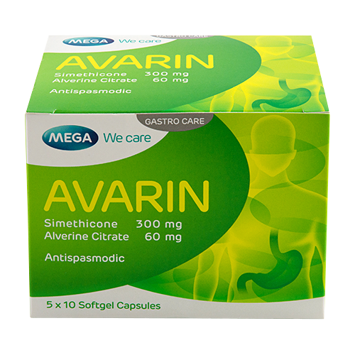
Alverine citrate
Is a non-antimuscarinic antispasmodic that acts directly on smooth muscle; it is used for the treatment of pain and smooth muscle spasm in IBS.
There were few side-effects reported during the 30 years (nausea, dizziness, pruritus, rash and headache).

Slide 9
Alverine citrate
The recommended dose for adults and children over 12 years is 60–120 mg up to three times daily.
It is not contraindicated during pregnancy and breastfeeding, but caution is advised in the first trimester of pregnancy.

Slide 10
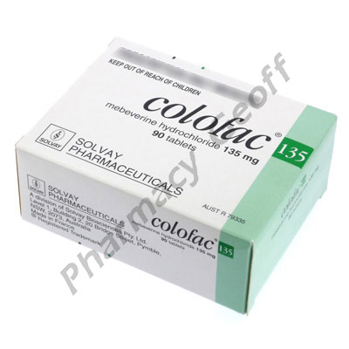
Mebeverine hydrochloride
Is a non-antimuscarinic antispasmodic that is claimed to act directly on the smooth muscle of the intestine without affecting normal gut motility.
Like alverine, mebeverine has no antimuscarinic side-effects and no contraindications or interactions with other drugs.

Slide 11
Mebeverine hydrochloride
Mebeverine hydrochloride is licensed for use in adults and children over 10 years of age.
It should be used in pregnancy only under medical supervision.
The dosage is 135 mg up to three times daily, taken 20 minutes before meals.

Slide 12
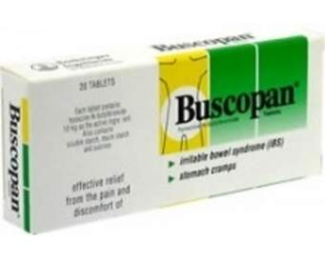
Hyoscine butylbromide
Is an antimuscarinic antispasmodic.
It is poorly absorbed from the gut and is claimed to act directly on the gut; any drug that is absorbed does not readily cross the blood–brain barrier.
Antimuscarinic side-effects have been reported.
hyoscine butylbromide is contraindicated in patients with glaucoma. Caution is also advised for men with prostate problems, elderly people and pregnant women.
The recommended dosage is three to eight 10 mg tablets daily, in divided doses, for adults, and 30mg daily for children aged 6–12 years.

Slide 13
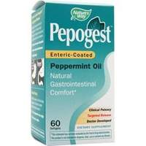
Peppermint oil
Menthol is the principal constituent of peppermint oil.
It has been shown to have a relaxant action on smooth muscle, it acts directly on the colon.
Peppermint oil is available as enteric-coated capsules containing 0.2mL oil.
The recommended dosage for adults is one or two capsules three times a day, preferably before food; it may be taken after food, but not immediately after.

Slide 14
Peppermint oil
The capsules should not be chewed, as peppermint oil can cause irritation of the mouth and oesophagus; in addition, the drug would be dispersed before reaching the colon.
People with heartburn may experience an exacerbation of symptoms even when the capsules are taken correctly.
Peppermint oil capsules are not contraindicated in pregnancy or breastfeeding, although the usual precautions should be observed.

Slide 15
Ispaghula husk
Ispaghula husk is licensed for the treatment of IBS as well as for constipation and diarrhoea.
One reviewer has stated that ispaghula can increase stool frequency and help pain but that it may aggravate bloating.
Two double-blind, placebo-controlled trials found that that ispaghula husk significantly improved overall wellbeing in patients with IBS

Slide 16
Antidiarrhoeals
The use of antidiarrhoeals such as loperamide is appropriate only on short-term basis. They improve diarrhoea, frequency of bowel movements, but not abdominal pain

