Slide 1
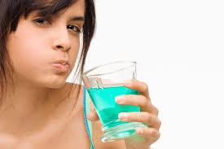
Gargles lab 5

Slide 2
Gargles
Gargles are aqueous solution used for treatment of pharynx and naso pharynx by forcing air from lung , it is held in throat for few moments then thrown out of the mouth. They are usually diluted with water before use such as phenol gargle .
Potassium chlorate and phenol gargle B.P.
Rx
Potassium Chlorate 3 g
Patent blue v 2 ml
Liquid phenol 1.5 ml
D.W Q.S 100 ml
Sig. 1table spoonful in half glass of warm water

Slide 3
Note:-
Stock solution of patent blue V contain 60 mg /100 ml
60 mg 100 ml
X 2 ml
X= 1.2 mg
Pot. Chl. used as anti-inflammatory.
Patent blue used as coloring agent.
Liquid phenol used as antiseptic.

Slide 4
1- Dissolve the pott. Chlorate in about 15 ml of warm water. 2- Cool before adding the liquefied phenol (very caustic). 3- Add the dye solution, filter if necessary. 4- Complete the volume by D.W.
procedure

Slide 5
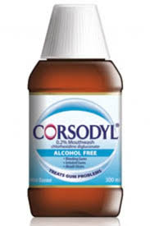
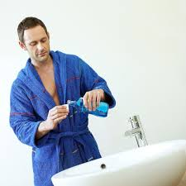
Mouth wash

Slide 6
Mouth wash:- are aqueous solutions, most often used for their deodorant ,refreshing or antiseptic effect. They may contain alcohol, glycerin, sweetener and flavoring agent.
Compound sodium chloride wash. B.P.
Rx
NaCl 1.5 mg
Na.bicarb 1 mg
Pepp. water Q.S 100 ml
Sig. to be used with equal volume of warm water
Procedure:-
By simple sol. Method
Note:-
Mouth washes are usually less medicated and more flavored than gargles.

