Slide 1

Inverse Laplace Transform (Part 1)
Al-Rasheed University Collage
Computer Techniques Engineering Department
Third Class / Engineering Analysis
Lec.3
Roweda.M.Mohammed

Slide 2
Inverse Laplace Transforms
If then is called the inverse Laplace transform of and is denoted by:
Some inverse Laplace transform :

Slide 3


Some Properties of the Inverse Laplace Transform
Linearity:
First Shifting:
Second Shifting:
Inverse L.T. of Derivative:
Inverse L.T. of Integral:

Slide 4
Example: Find inverse Laplace transform of:
Solution: By using Linearity:

Slide 5
Partial Fraction
To find the inverse Laplace transform we use transform pairs along with partial fraction expansion:
F(s) can be written as;
Where P(s) & Q(s) are polynomials in the Laplace variable, s.
We assume the order of Q(s) ≥ P(s), in order to be in proper form. If F(s) is not in proper form we use long division and divide Q(s) into P(s) until we get a remaining ratio of polynomials that are in proper form.

Slide 6
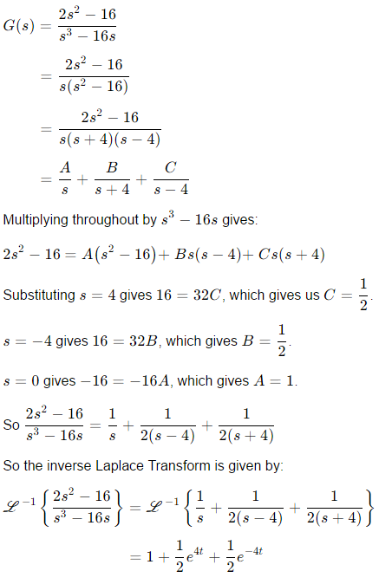
Partial Fraction
Obtain the inverse Laplace transforms of the following functions:

Slide 7
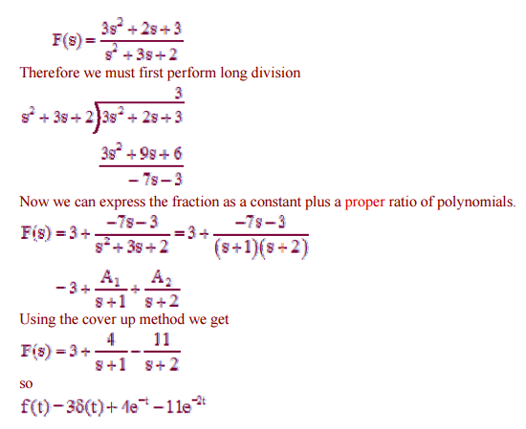
Partial Fraction
For the fraction shown below, the order of the numerator polynomial is not less than that of the denominator polynomial.

