Slide 1

The Inverse Z-Transform
Al-Rasheed University Collage
Computer Techniques Engineering Department
Third Class / Engineering Analysis
Lec.6
Roweda.M.Mohammed

Slide 2
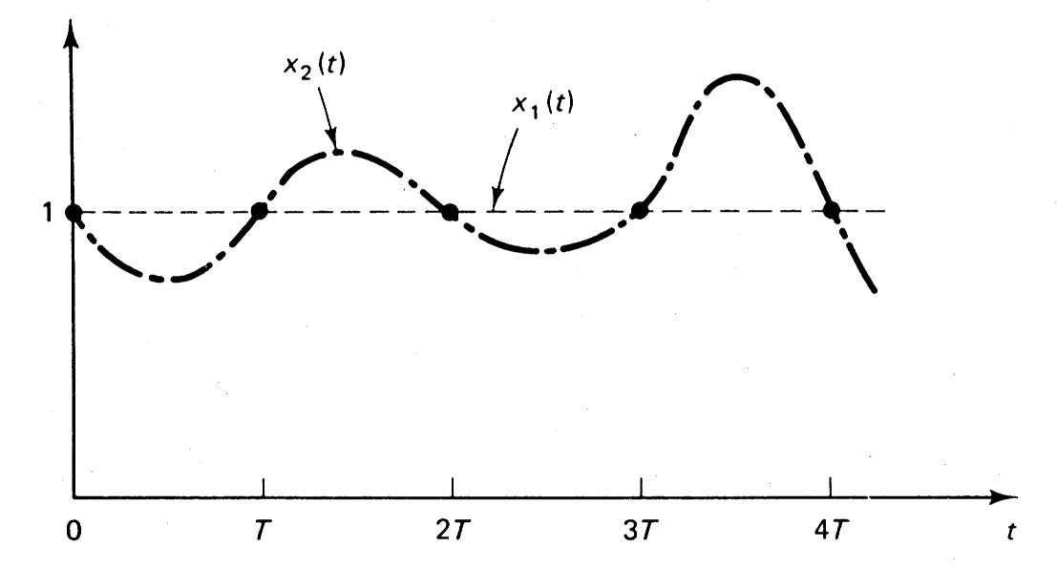
The Inverse Z-Transform
The notation for the inverse Z transform is Z⁻¹. The inverse z transform of X(z) yields the corresponding time sequence x(k).
Only the time sequence at the sampling instants is obtained from the inverse Z transform.
The inverse z transform yields a time sequence that specifies the values of x(t) only at discrete instants of time.
Many different time functions x(t) can have the same x(kT).

Slide 3
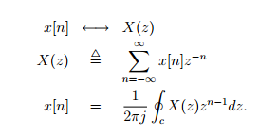
Evaluation of the contour integral is not always trivial. Common Z-transform pairs have been tabulated. X(z) has to be manipulated to reach a form similar to the tabulated pairs; also the properties of the Z-transform are often used in this process. We’ll discuss few approaches to evaluate the inverse Z-transform.

Slide 4







Inverse z-Transform By Inspection: Examples
The inverse Z-transform for the function $X(z)$ is defined as:
Example:
Find the inverse z-transform of
Solution:
We get,
Using table,
Example :
Find the inverse z-transform of
Solution:
We get,
Using table,

Slide 5
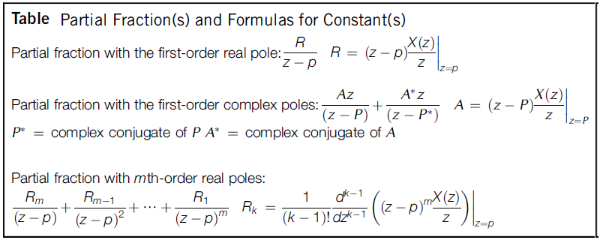
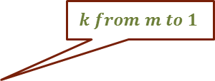
Inverse z-Transform: Using Partial Fraction
$$k from m to 1$$

Slide 6
Poles and Zeros in the z Plane
  The locations of the poles and zeros of X(z) determine the characteristics of x(k), the sequence of values or numbers.
  We often use a graphical display in the z plane of the locations of the poles and zeros of X(z).
poles at z=-1, z=-2
zeros at z=0, z=-0.5

Slide 7










Inverse z-Transform: Using Partial Fraction
Example:
Find the inverse z-transform of
Solution:
First eliminate the negative power of z.
Dividing both sides by z,
Finding the
constants:
$$multiplying by z$$
Therefore, inverse z-transform is:

Slide 8
Inverse z-Transform: Using Partial Long Division
Example:
  Inverse z transform using long division
  , if ROC |Z|< 1

Slide 9

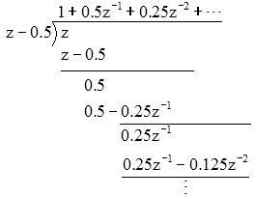
Example:
  Inverse z transform using long division
  , if ROC |Z|> 0.5

