Slide 1

Numerical Method for First Order Differential Equation
Al-Rasheed University Collage
Computer Techniques Engineering Department
Third Class / Engineering Analysis
Lec.10
Roweda.M.Mohammed

Slide 2

Numerical Method for First Order Differential Equation
A simple first order differential equation has general form:
y(xo)=yo initial condition
Equation (1.1) can be solved using Euler method.

Slide 3
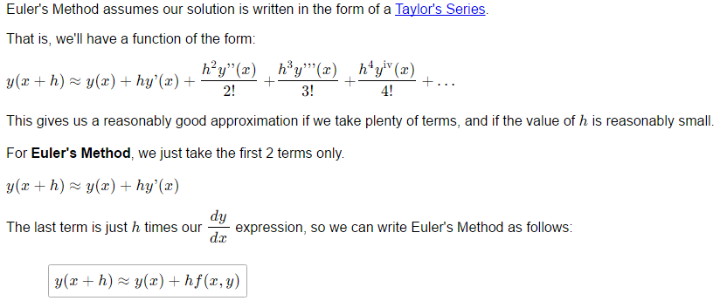
Euler Method

Slide 4
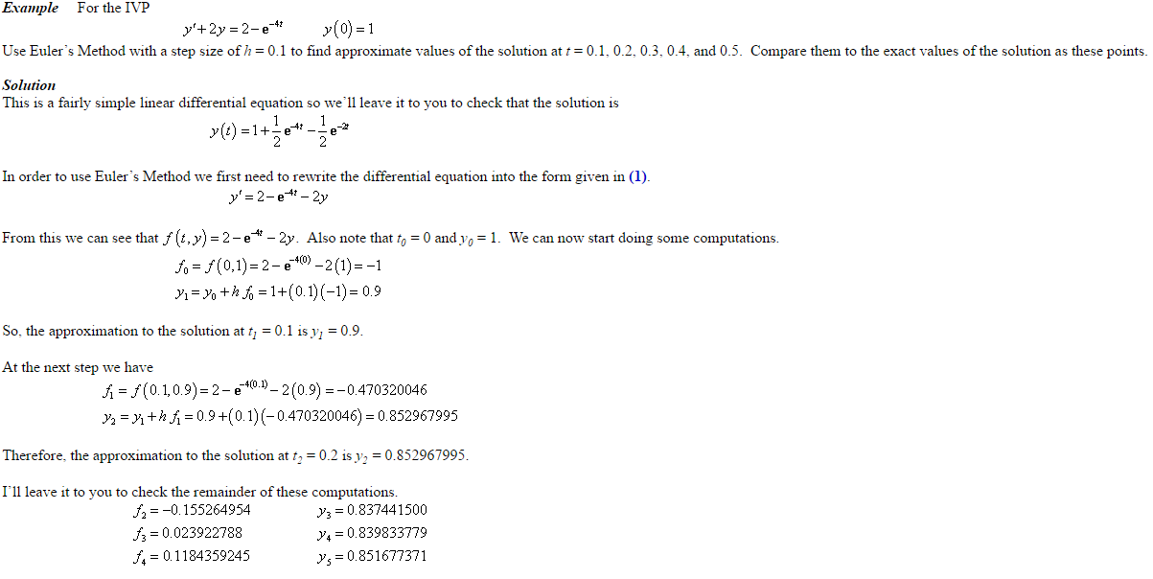

Slide 5
