Slide 1
كلية الرشيد الجامعة قسم هندسة تقنيات الحاسوب
Instruments and Measurements
Lecture (9)
TRANSDUCERS TYPES
by :
Ass.Lecturer Ayia A.Salam

Slide 2
Selecting a Transducers
When selecting transducer, it has to be compatible with its application;
(1) Operating Principle:
~ The transducer are many times selected on the basis of operating principle used by them. The operating principles used may be resistive, inductive, capacitive, etc.
(2) Operating range:
~ it should maintain range requirements and good resolution.
(3) Sensitivity:
~ it must be sensitive enough to allow sufficient output.
(4) Frequency response and resonant frequency:
~ is the transducer flat over the needed range.

Slide 3
(5) Environmental Compatibility:
~ It should be assured that the transducer selected to work under specified environmental conditions maintains its input-output relationship and does not break down. For example, the transducer should remain operable under its temperature range.
(6) Insensitivity to Unwanted Signals:
~ The transducer should be minimally sensitive to unwanted signals and highly sensitive to desired signals.
(7) Usage and ruggedness:
~mechanical and electrical intensities versus size and weight.
(8) Electrical:
~ The electrical aspects that need consideration while selecting a transducer include the length and type of cable required. Attention also must be paid to signal to noise ratio in case the transducer is to be used in conjunction with amplifiers.

Slide 4
Resistive Position Transducers.
It is also called displacement transducer.
The physical variation under measurement cause a resistance change in the sensing element.
The resistive transducer can work both as the primary as well as the secondary transducer. The primary transducer changes the physical quantities into a mechanical signal, and secondary transducer directly transforms it into an electrical signal.

Slide 6
Working Principle of Resistive Transducer
The resistive transducer element works on the principle that the resistance of the element is directly proportional to the length of the conductor and inversely proportional to the area of the conductor.
Where R – resistance in ohms. A – cross-section area of the conductor in meter square. L – Length of the conductor in meter square. ρ – the resistivity of the conductor in materials in ohm meter.

Slide 7
Advantages of Resistive transducer
Both AC and DC current and voltage is appropriate for the measurement of variable resistance.
The resistive transducer give the fast response.
It is available in various sizes and having a high range of resistance.

Slide 8
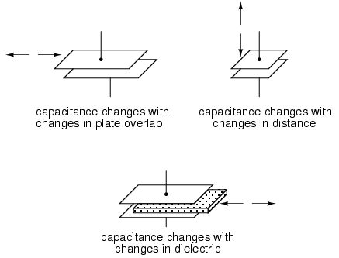
Capacitive Transducers
$C=\frac{ε_{r}ε_{0}A}{d} (farads)$
Capacitive transducers are passive transducers that determine the quantities like displacement, pressure and temperature etc. by measuring the variation in the capacitance of a capacitor.
The capacitive transducers comprises of two parallel metal that are separated by the material such as air, which is called as the dielectric material.
In the typical capacitor the distance between two plates is fixed, but in the variable capacitance transducers the distance between the two plates is variable.

Slide 9
Above is the formula of the parallel-plate capacitor where,
$ε_{r}$= relative permittivity.
A = Area of the plate, in square meters.
$ε_{0}$ = 8.854x${10}^{−12}$, in farad per meter (permittivity of free space).
d= the plate spacing in meters.
From the above equation is it clear that the capacitance of the capacitor is dependent on the area of the two plates, the distance between two plates and the permittivity of the material.
Hence, by varying either area, distance or permittivity, the non-electrical quantities can be determined.
So basically, it can be concluded that there exist 3 methods by which the capacitance of the capacitive transducer can be varied. The methods are:
By the change in the area of overlapping of the two plates i.e., A
By the change in the distance, d between the two plates
By the change in relative permittivity of dielectric material present between the two plates.

Slide 10
The Advantages of Capacitive Transducer:
The sensitivity of capacitive transducer is high.
It requires small power to operate.
It has good frequency response.
The Disadvantages of Capacitive Transducer.
Sensitivity to temperature variations
Difficulties in designing

Slide 11
Inductive Transducers
Inductive transducers are mainly used for the measurement of displacement.
Inductive transducers work on the principle of inductance change due to any appreciable change in the quantity to be measured.
Single coil acts as transducers
Two coils acting as excitation coil and output coil
The displacement to be measured is arranged to cause variation in any of three variables:
Number of turns
Geometric configuration
Permeability of the magnetic material or magnetic circuit.

Slide 12
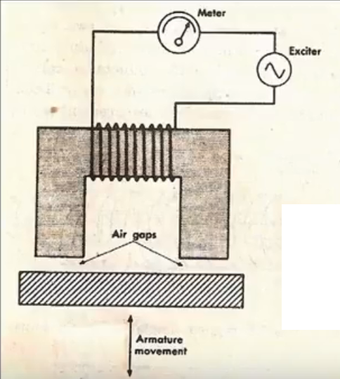
Simple inductance type transducer
When the mechanical element whose displacement is to be measured, is moved. This movement changes the flux generated by the circuit which changes the inductance of the circuit and the corresponding output.

Slide 13
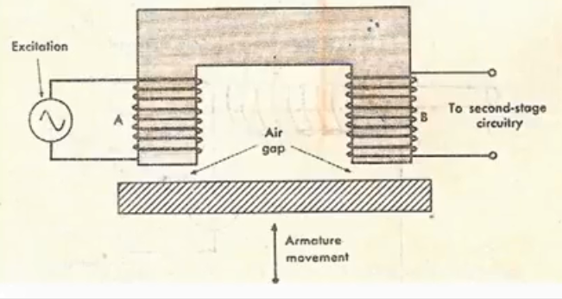
Two coil mutual inductance type transducer
In this arrangement there are 2 coils. Coil A is the excitation coil and coil B is output coil.
Inductance of B changes due to change in position of the armature which is connected to the mechanical element whose motion is to be measured.

