Slide 1


DC&AC Bridges
كلية الرشيد الجامعة
قسم هندسة تقنيات الحاسوب
Instruments and Measurements
Lecture (8)
by :
Msc. Ayia A.Salam

Slide 2
Summery
Introduction
Types of bridges
Wheatstone bridge circuit
Wheatstone bridge example
Maxwell Bridge
Schering Bridge
Wien Bridge

Slide 3
Introduction
DC & AC Bridge are used to measure resistance, inductance, capacitance and impedance.
Operate on a null indication principle. This means the indication is independent of the calibration of the indicating device or any characteristics of it.
Very high degrees of accuracy can be achieved using the bridges

Slide 4
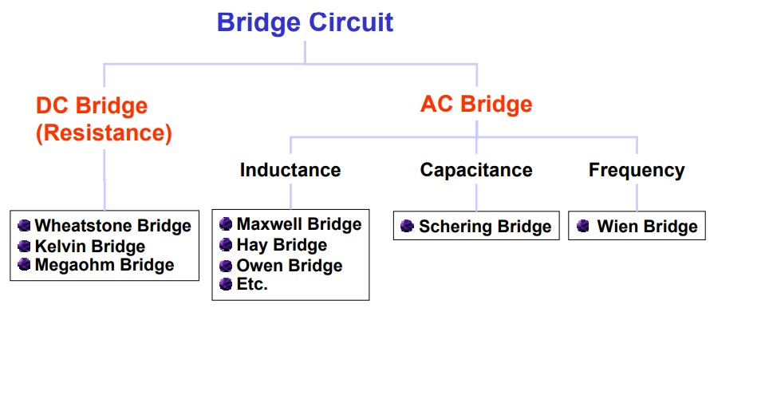
Types of bridge

Slide 5
DC Bridges
The Wheatstone Bridge

Slide 6
Wheatstone Bridge
A wheatstone bridge was originally developed by Charles Wheatstone to measure unknown resistance.
Although today digital multimeters provide the simplest way to measure a resistance. The wheatstone bridge can still be used to measure very low values of resistances down in the milli-ohms range.

Slide 7
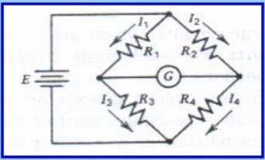

Wheatstone Bridge
Definition: Basic circuit configuration consists of two parallel resistance branches with each branch containing two series elements (resistors). To measure instruments or control instruments.
$R_{1}R_{4}=R_{2}R_{3}$
$R_{4}$=$\frac{R_{2}R_{3}}{R_{1}}$

Slide 8
How a Wheatstone Bridge works?
The dc source, E is connected across the resistance network to provide a source of current through the resistance network.
The sensitive current indicating meter or null detector usually a galvanometer is connected between the parallel branches to detect a condition of balance.
When there is no current through the meter, the galvanometer pointer resets at 0 (midscale).
Current in one direction causes the pointer to deflect on one side.
The bridge is balanced when there is no current through the galvanometer or the potential across the galvanometer is zero

Slide 9

At balance condition;
Voltage across R1 and R2 also
equal, therefore
$I_{1}R_{1}=I_{2}R_{2}$ ....... (1)
Voltage across R3 and R4 is equal
$I_{3}R_{3}=I_{4}R_{4}$ ........ (2)
No current flows through galvanometer G when the bridge is balance, therefore:
$I_{1}=I_{3}$ and $I_{2}=I_{4}$ .......(3)

Slide 10

Substitute (3) in Eq (2),
$I_{1}R_{3}=I_{2}R_{4}$ ....... (4)
Eq(4) devide Eq(1)
$\frac{R_{1}}{R_{3}}=$ $\frac{R_{2}}{R_{4}}$
Then rewritten as
$R_{1}R_{4}=R_{2}R_{3}$ ......... (5)

Slide 11
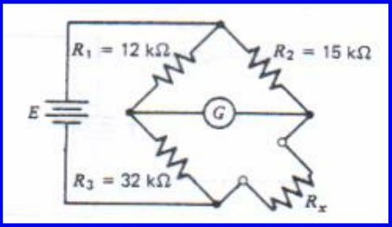

Example
The figure below consists of the following, $R_{1}=12 KΩ$, $R_{2}=15 KΩ$, $R_{3}=32 KΩ$. Find the unknown resistance $R_{x}.$
Assume a null exists ( current through the galvanometer is zero).
Sol.
$R_{x}$ $R_{1}$= $R_{2}$ $R_{3}$
$R_{x}$= $\frac{R_{2} R_{3}}{R_{1} }$ = $\frac{15 ×32}{12}$ = 40 KΩ

Slide 12
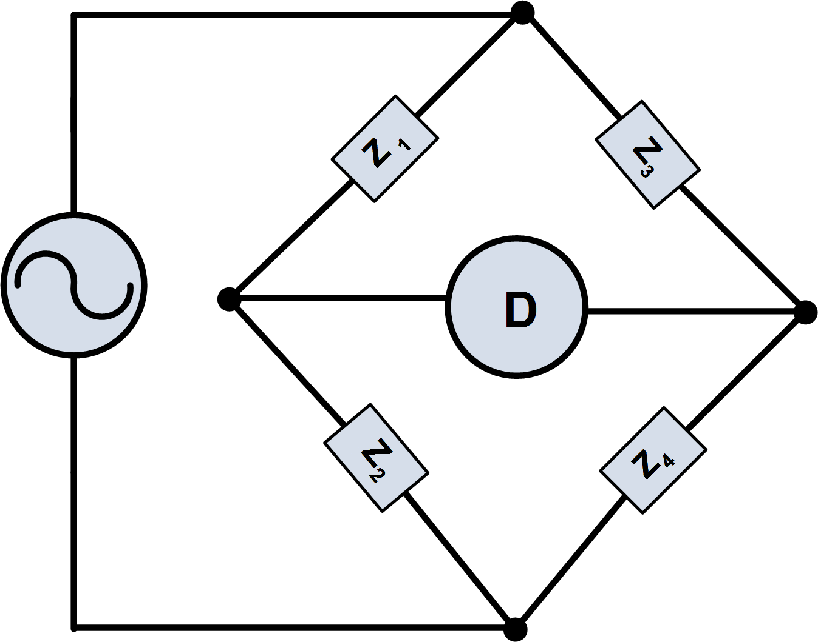

AC Bridges
AC bridges are used to measure inductance and capacitance and all ac bridge circuit are based on the wheatstone bridge. The general ac bridge circuit consists of 4 impedances, an ac voltage source, and detector as shown in figure below. In ac bridge circuit, the impedances can either pure resistance or complex impedance.
$\frac{Z_{1}}{Z_{3}}$ = $\frac{Z_{2}}{Z_{4}}$

Slide 13
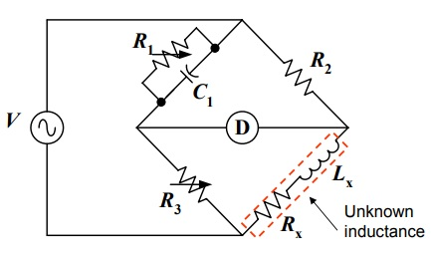

Maxwell Bridge
Measure unknown inductance in term of known capacitance.
At balance point :
$R_{x}$= $\frac{R_{2}R_{3}}{R_{1}}$ and $L_{x}$=$R_{2}$ $R_{3}$ $C_{1}$

Slide 14
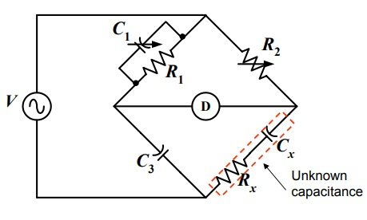

Schering Bridge
Used extensively for the measurement of capacitance
$R_{x}$= $R_{2}\frac{C_{1}}{C_{3}}$ and ${ C}_{x}$= $C_{3}\frac{R_{1}}{R_{2}}$

Slide 15
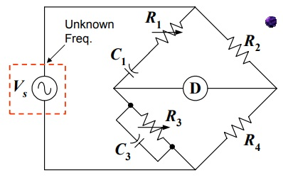

Wien Bridge
Measure frequency of the voltage source using series RC in one arm and parallel RC in the adjoining arm.
$f=$ $\frac{1}{2π\sqrt{C_{1}C_{3}R_{1}R_{3}}}$

