Slide 1


كلية الرشيد الجامعة
قسم هندسة تقنيات الحاسوب
Instruments and Measurements Lecture(4)
Basic Electrical Measuring Instruments
by :
ASS.Lecturer. Ayia A.Salam

Slide 2
Classification of Electrical Measuring Instruments
Electrical Instruments may be divided into two categories, that are;
1. Absolute instruments,
2. Secondary instruments.

Slide 3
Absolute instruments
Absolute instruments or Primary instruments:- These instruments gives the magnitude of quantity under measurement in term of physical constants of the instrument e.g. Tangent Galvanometer.
These instruments give the value of electrical quantity in terms of absolute quantities of the instruments and their deflections.
In this type of instruments no calibration or comparison with other instrument is necessary.
They are generally not used in laboratories and are seldom used in practice by electricians and engineers. They are mostly used as means of standard measurements and are maintained lay national laboratories and similar institutions.

Slide 4
Some of the examples of absolute instruments are:
* Tangent galvanometer
* Raleigh current balance
* Absolute electrometer

Slide 5
Secondary instruments.
In the secondary instruments the deflection gives the magnitude of electrical quantity to be measured directly. These instruments are required to be calibrated by comparison with another standard instrument before putting into use.
Basic Secondary instruments which we use
Multi meter
Clamp meter
Ammeter
Voltmeter

Slide 6
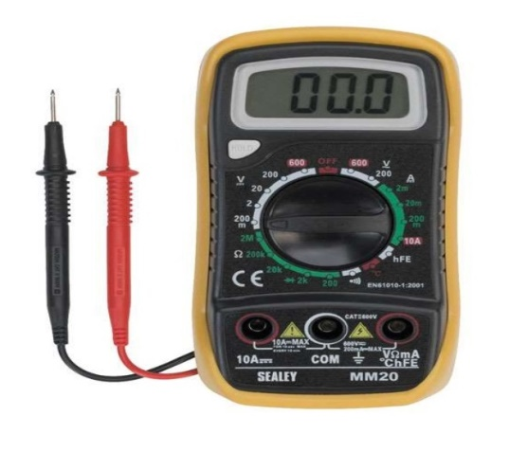
Multi Meter
A multimeter or a multitester, also known as a VOM (Volt-Ohm meter or Volt-Ohm-milliammeter), is an electronic measuring instrument that combines several measurement functions in one unit. A typical multimeter would include basic features such as the ability to measure voltage, current, and resistance.
A multimeter can be a hand-held device useful for basic fault finding and field service work, or a bench instrument which can measure to very high degree of accuracy.

Slide 7
Parts of Multi Meter
A multimeter is has three parts:
Display
Selection Knob
Ports
- The display usually has four digits and the ability to display a negative sign.
- The selection Knob allows the user to set the multimeter to read different things such as milliampers (mA) of current, voltage (V) and resistance (Ω).
- Two probes are plugged into two of the ports. COM stands for common and is almost always connected to Ground of a circuit. 10A is the special port used when measuring large currents (greater than 200mA). mAΩ is the port that allows the measurement of current (up to 200 mA), voltage (V) and resistance (Ω).

Slide 8
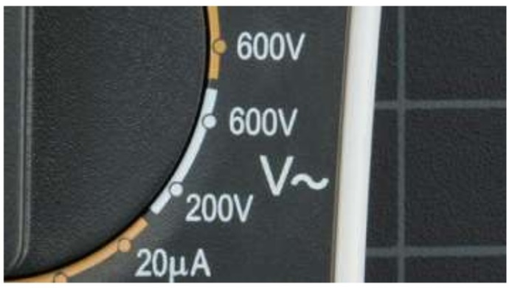
Measuring AC Voltage
*Use the V with a wavy line to measure AC Voltage
How to measure AC Voltage
Plug the black probe into COM and the red probe into mAVΩ.
Select the knob in the desired voltage range
Stick both the probes in the two point whose potential difference (Voltage) is to be measured
If the selected range is small the meter will simply show 1, so increase the range.

Slide 9
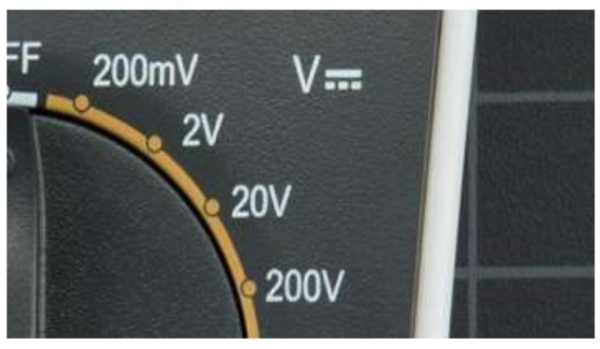
Measuring DC Voltage
*Use the V with a straight line to measure DC Voltage
How to measure DC Voltage
Plug the black probe into COM and the red probe into mAVΩ.
Select the knob in the desired voltage range
Connect the black probe to the battery’s ground or
(-) and the red probe to power or (+)
If the selected range is small the meter will simply show 1, so increase the range.

Slide 10
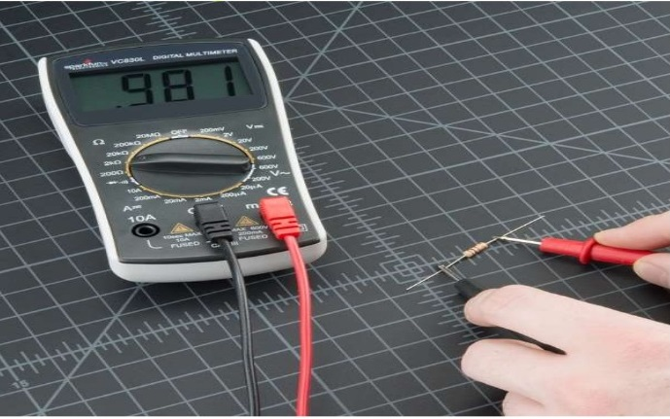
Measuring Resistance
Pick out a random resistor and set the multimeter to the 20KΩ setting . Then hold the probes against the resistor legs.
In this case, the meter reads 0.97, meaning this resistor has a value of 0.97kΩ, or about 1kΩ or 1000Ω.
If the multimeter reads 1 or display OL, it’s overloaded. You will need to try a higher mode such as 200kΩ mode or 2MΩ mode
If multimeter reads 0.00 or nearly zero, then you need to lower the mode to 2kΩ or 200Ω.

Slide 11
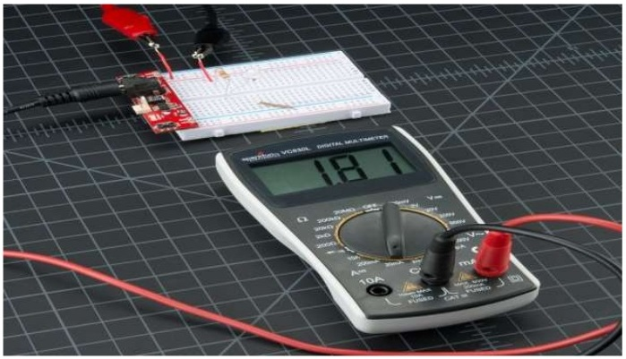
Measuring Current
Reading current is one of the trickiest and most insightful readings in the world of embedded electronics. It’s tricky because you have to measure current in series.
We’ll need to physically interrupt the circuit to measure the current.
Breaks the main power line and connect the line through the multi meter, so that it can measure the current as it “flows” through to the multimeter into the circuit.
Set the desired current range.

Slide 12
Measuring Continuity
Continuity testing is the act of testing the resistance between two points. If there is very low resistance (less than a few Ω’s), the two points are connected electrically, and a tone is emitted.
Set the multimeter to ‘Continuity’ mode.
Now touch the probes together. The multimeter should emit a tone
Touch the both probes to the both ends of wire which is to be tested.
If a sound emits the wire is good to use.
If no sound is emitting check the wire for any breakage.

Slide 13
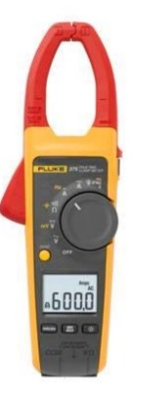
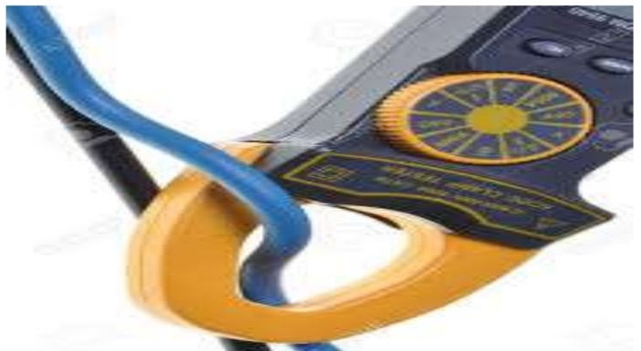
Clamp Meter
Clamp meter (current clamp or
current probe) is an electrical device having two jaws which open to allow clamping around an electrical conductor. This allows properties of the electric current in the conductor to be measured, without having to make physical contact with it, or to disconnect it for insertion through the probe.

Slide 14
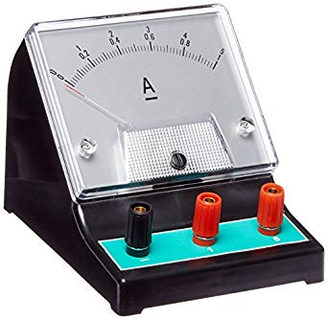
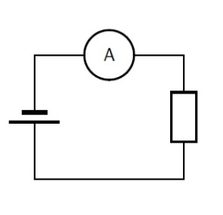
Ammeter
An ideal ammeter is a two terminal device, also polarized. It is connected in series with circuit elements to measure the sign and magnitude of the current flowing through that component.

Slide 15
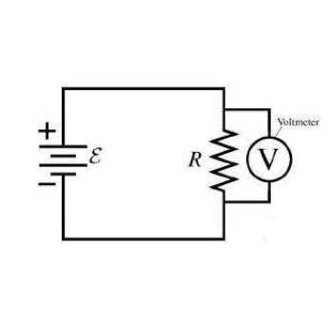
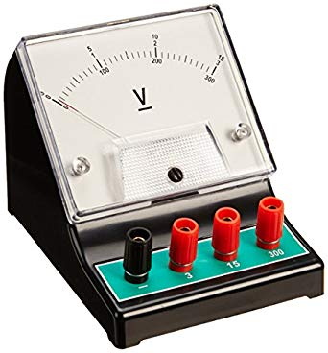
Voltmeter
An ideal voltmeter has two terminals and senses the voltage between the terminals where they may be connected to a circuit. Ideally the voltmeter has infinite resistance.

