Slide 1


كلية الرشيد الجامعة
قسم هندسة تقنيات الحاسوب
Instruments and Measurements
Lecture (8)
TRANSDUCERS
by :
Ass.Lecturer. Ayia A.Salam

Slide 2
Contents
What is transducer
Block diagram of transducer
Classifications of transducer
Selection criteria of the transducers

Slide 3
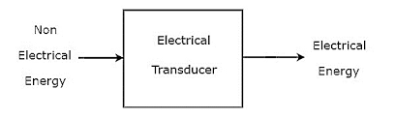
What is Transducer?
A transducer is a device which transforms a non-electrical physical quantity (temperature, sound or light) into an electrical signal (voltage, current, capacity . . . )
In another word it is a device that capable of converting the physical quantity into a proportional electrical quantity such as voltage or current.

Slide 4
What is Transducer?
The transducer is defined as the device which convert the one form of energy into another form of the energy.
Examples:
Temperature transducers
Thermocouples
Resistance temperature detectors
Thermistors
Displacement transducers
Strain gauge

Slide 5
ELECTRICAL TANSDUCERS
The electrical transducers is one which converts the non electrical quantity into equivalent electrical quantity.
Non-electrical quantity such as force , displacement, stress, temperature.
Electrical quantity such as current, voltage

Slide 6
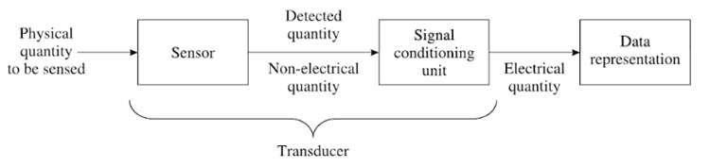
Block diagram of transducers
Transducer contains two parts that are closely related to each other , which are the sensing element and transduction element.
The sensing element is called as the sensor. It is device producing measurable response to change in physical conditions.
The transduction element convert the sensor output to suitable electrical form.

Slide 7
CLASSIFICATION OF TRANSDUCERS
The transducer is of many types, and they can be classified by the following criteria.
By transduction used.
As primary and secondary transducers.
As passive and active transducers.
As analog and digital transducers.
As transducers and inverse transducers.

Slide 8
1- classification based on the principle of transduction
The transducer is classified by the transduction medium. The transduction medium may be resistive, inductive or capacitive depends on the conversion process that how input transducer converts the input signal into resistance, inductance and capacitance respectively.

Slide 9
2- primary and secondary transducers
Primary Transducer – The transducer consists the mechanical as well as the electrical devices. The mechanical devices of the transducer change the physical input quantities into a mechanical signal. This mechanical device is known as the primary transducers.
Secondary Transducer – The secondary transducer converts the mechanical signal into an electrical signal. The magnitude of the output signal depends on the input mechanical signal.

Slide 10
3-passive and active transducers
The transducer is classified as the active and passive transducer.
Passive Transducer – The transducer which requires the power from an external supply source is known as the passive transducer. They are also known as the external power transducer. The capacitive, resistive and inductive transducers are the example of the passive transducer.
Active Transducer – The transducer which does not require the external power source is known as the active transducer. Such type of transducer develops theirs owns voltage or current, hence known as a self-generating transducer. The output signal is obtained from the physical input quantity.

Slide 11
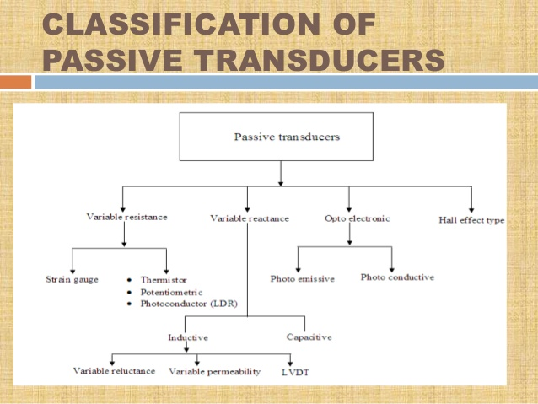

Slide 12
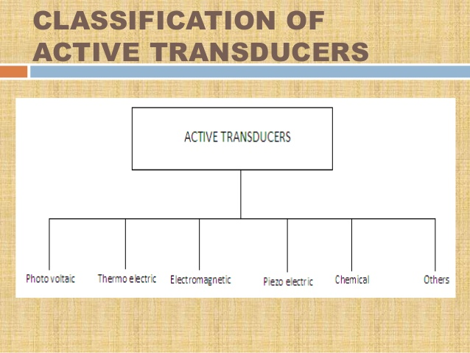

Slide 13
4- Analog and digital transducers
The transducer can also be classified by their output signals. The output signal of the transducer may be continuous or discrete.
Analog Transducer – converts input signal into output signal, which is a continuous function of time such as strain gauge, thermistor.
Digital Transducer – converts input signal into output signal in form of pulses. These transducers are becoming more popular nowadays because of advantages associated with digital measuring instruments and also due to the fact that digital signals can be transmitted over a long distance without causing much distortion.

Slide 14
5- transducers and inverse transducers
Transducer – The device which converts the non-electrical quantity into an electric quantity is known as the transducer.
Inverse Transducer – The transducer which converts the electric quantity into a physical quantity, such type of transducers is known as the inverse transducer. The transducer has high electrical input and low non-electrical output.

Slide 15
On the basis of transduction principle used
Resistive Transducers
Capacitive Transducers
Inductive Transducers
Voltage and Current Transducers

Slide 16
Selection criteria of the transducers
Operating principle
Sensitivity
Operating range
Accuracy
Errors
Environment capability
Insensitive to unwanted signal
stability

