Slide 1
Microscopic examination
Lab 3

Slide 2

Centrifugation
5-15 ml --- centrifuge 500rpm for 3 min
Load drop of precipitate on slid and cover it with cover slide
Examine under 10x and 40x

Slide 3
The precipitate classified into living precipitate and non living precipitate
1- cast abnormal structures in urine, formed as a result to:-
Increasing in albumin excretion from urinary bladder
Destroying of epithelial cells
Gastroenteritis , jaundice ,chronic anemia

Slide 4
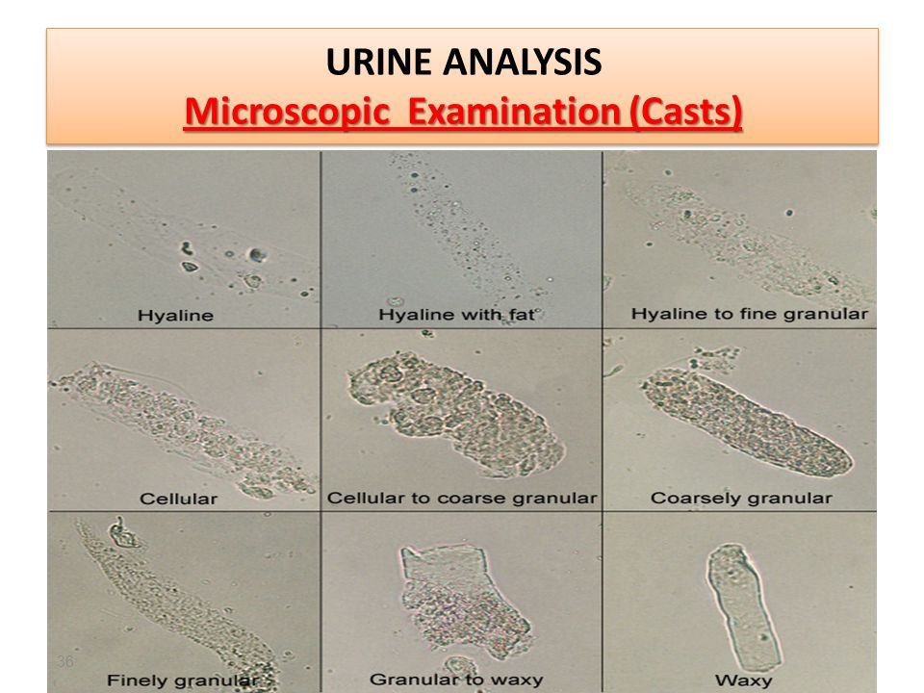

Slide 5
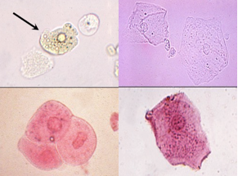
2- Epithelial cell
Do not refer to pathogenic case in women

Slide 6
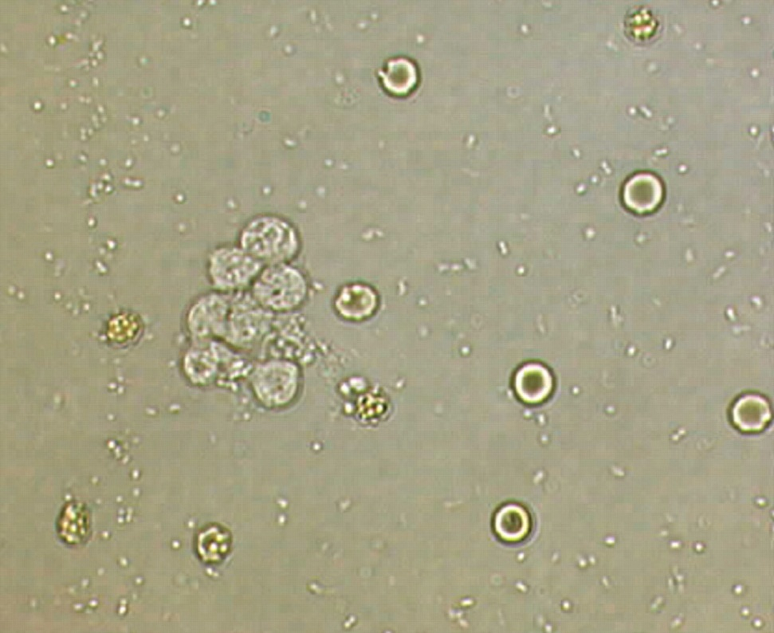
3- RBCs
It appearing in these cases:-
Kidney bleeding
Stone
Bilharzias
Urinary tract bleeding
No cell …. Nil

Slide 7
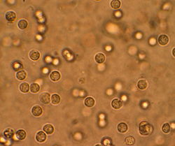
4- Pus cells
Bigger than RBCs ,have nucleus

Slide 8
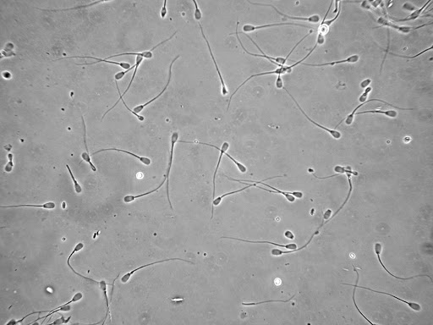
Sperms
Do not refer to pathogenic case in men

Slide 9
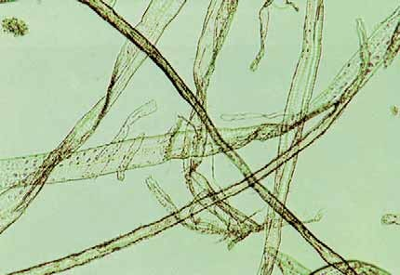
6- Fibers
Appear after hematurea(fibrin clotting)

Slide 10
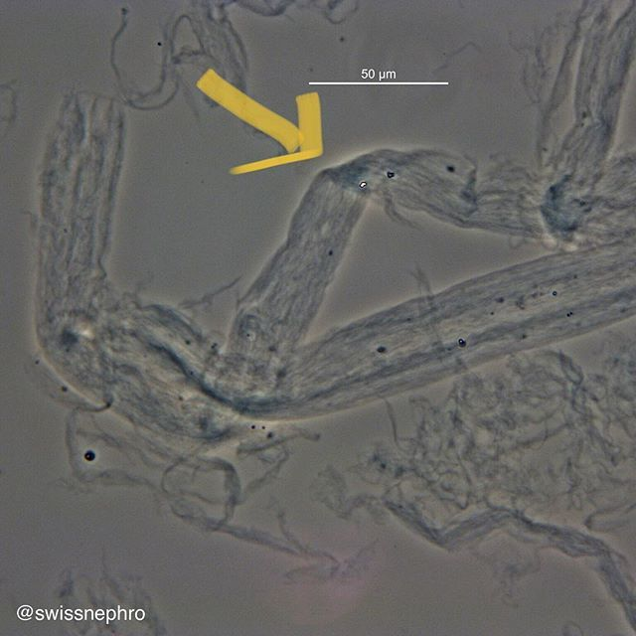
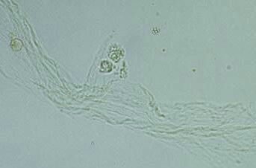
7- Mucus thread

Slide 11
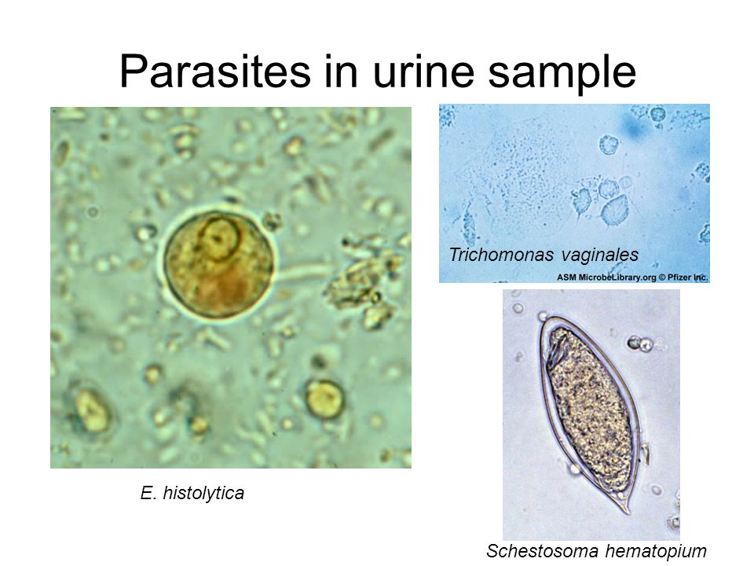
8- Microorganism
Rods and cocci | Bacteria
Candia | Yeasts
Trichomonas virginals | Protozoa
Enterobius vermicularis Schistosoma haematobium | Parasites

Slide 12
9- Crystals
Differ according to urine PH
Acidic pH : uric acid ,amorphous urate ,calcium oxalate
Neutral pH: amorphous phosphate ,calcium phosphate ,triple phosphate ,calcium sulphate
Alkaline pH : ammonium urate
10- Bubbles and glass fragments

Slide 13
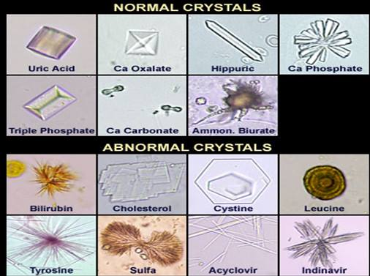

Slide 14
Urine culture
Urine sample --- centrifugation ---- culturing
1- CLED media used for counting the no of bacteria
10⁵ cell/ ml --- acute infection
10³ cell/ ml--- presence of contamination
Or patient in antibiotic therapy
Less than 10² cell /ml --- contamination with normal flora
2 –Chromogenic agar: used for detection of bacterial infection by direct identification depending on colony characters

