Slide 1
Antimicrobial Drugs Used in Combination

Slide 2
There are five cases that used two antibiotics or more in treatment such as :-
1- Undiagnosed infection :- in pathogenic cases ,the causative agent should be diagnosed firstly treatment ; but in some cases are unstable relationship between disease symptoms and bacterial causative agents ,ex:- Acute UTI and RTI caused by agent that reveals same symptoms but there is no specific antibiotic lead to inhibit all microbial causative agent .
2- Mixed infections: - there is no specific antibiotic (against) all microbial causative agent.

Slide 3
3- Preventing or delaying development of antibiotic resistance:-
In some pathogenic cases may recommended two antibiotic to reduce the possibility developed microbial strain resistant to antibiotics, because the frequency of the resistant codes for more antibiotics has different mechanism for single antibiotic resistances ex:- if the possibility of the resistance for the antibiotic (A) in one microbe is A= 10⁻⁵ and to the antibiotic (B) is B= 10⁻⁷, the possibility resistance for both antibiotics A and B is 10⁻⁵+ 10⁻⁷= 10⁻¹² ( it is rare frequency ) .
4- Synergetic effect: - in some sever infections such as (Septicemia), it is may used two or more antibiotics together in order to eliminate the disease.

Slide 4
- To reduce the toxicity of some highly toxic antibiotics: - the effect of low dosage of two combined antibiotics (synergetic) ,it is same effect for any dosage of antibiotics (non-synergetic).
In the treatment of TB 1/2 dose of Streptomycin +1/2 dose
Rifampin
Cause liver damage
Cause renal damage
Using full dose of streptomycin causing damage in kidney , while Rifampin ,causing damage in liver ,for that , we recommended to use half dose for each above of antibiotic in order to appears same effect and reduced side effects .

Slide 5
There are many methods to observe the effect of antibiotics combination :
Diffusion method: it is simple method used to estimate the effect of combined antibiotics (discs or strips) no m.o ; this test done in Petri dishes containing Muller Hinton agar the cultural media inoculated with bacteria ,then the antibiotic applied on the agar surface in 90 degree angle (strips) and a suitable distance (discs) by using sterilized forceps and incubated at 37 C for 18 hr .and note the results .
Mechanisms of Combination
When 2 drugs act together their combined effect may be :
1- Indifferent effect : when the activity of both combined drugs is unaffected by the presence of the other

Slide 6
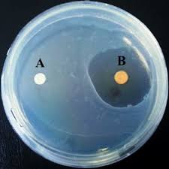
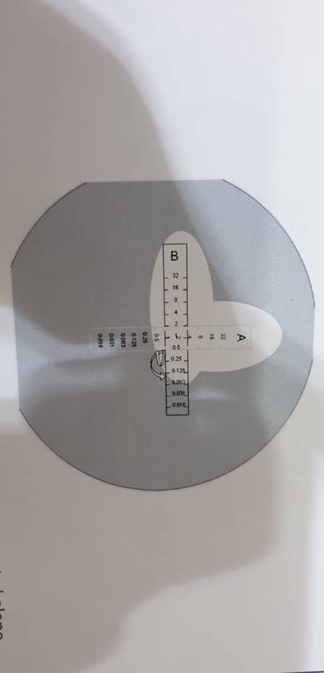

Slide 7
Indifference: The MIC of antimicrobial A was 0.1 mg/L when tested alone or in combination with antimicrobial B ; the MIC of antimicrobial B was 0.5 mg/L when tested alone in combination with antimicrobial .
2- Antagonistic effect : when the activity of one drug is reduced by the preset the other ;when the activity of one antibiotic affected by the second antibiotic ,the antagonist effect will appeared .Ex :- Mixing Bacteriostatic drug such as (Chloramphenicol and Tetracycline )with Bactericidal drugs such as (Aminoglycoside ), the antagonistic will occurred when the first antibiotic arrived to infected organ before the second one ;this case shown clearly in bacteria that causes meningitis .

Slide 8
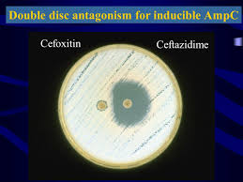

Slide 9
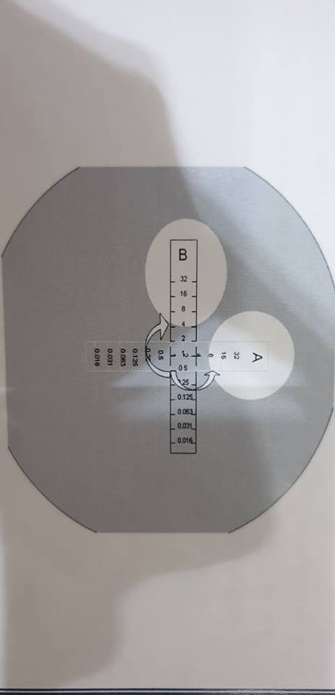

Slide 10
Antagonism : The MIC of antimicrobial A was 1.0 mg/L when tested alone ,but was 8.0 mg/L when tested in combination with antimicrobial B; the MIC of antimicrobial B was 0.5 mg/L when tested alone , but was 4.0 mg/L when tested in combination with antimicrobial A .
3- Synergetic effect: When the activity of both drugs is significantly greater than that of either acting alone in the same concentration.
Ex :- Methoprim (Trimethoprime + Sulfonamide )
Para amino benzoic acid dihydrofolic acid folic acid
(PABA) Sulfonamide Trimethoprime

Slide 11
The effect and activity of synergetic antibiotics it is greater than activity of antibiotic alone: also the synergetic antibiotics may causing blockage in microbial metabolism , pathway:
The above two antibiotics have double blockage (intermediate metabolite) ;while Trimethoprime prevent converting the dihydrofolic acid to folic acid ,for that inhibition action occurred in – two sites of the biological or metabolism pathways.

Slide 12
Synergy : The MIC of antimicrobial A was 1.0 mg/L when tested alone ,but was 0.125 mg/L when tested in combination with antimicrobial B ; the MIC of antimicrobial B was 0.5 mg/L when tested alone ,but was 0.063 mg/L when tested in combination with antimicrobial A .

Slide 13
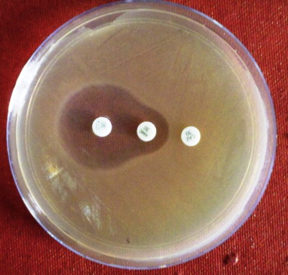

Slide 14
