Slide 1
Test of antibiotic susceptibility (sensitivity)

Slide 2
Microbial susceptibility to different types of antibiotics could be estimated through the ability of these antibiotics to inhibit the microbial growth, sensitivity could be measured by many methods qualitative and quantitative.
The purpose of this test is to know if the organism either sensitive or resistant to some antibiotics that used to treat the patients before applying a sensitivity test we should notice the following:

Slide 3
1- The genetic background for microbe sensitivity in vitro since some microbes pocess mutations .
2- The sensitivity range of strains under test in comparison with the same species .
3- Information about the antibiotic under test : toxicity ,chemical composition , absorption by the body and mode of action .
4- Patients immune state .
Antimicrobial drugs act in one of several ways :
Selective toxicity.
Inhibition of cell membrane synthesis and function.
Inhibition of protein synthesis.
Inhibition of cell nucleic acid synthesis.

Slide 4
Diffusion methods of sensitivity testing
This method is done by using solid media inoculated previously with the microbe under test, the antibiotics will diffuse to the agar during incubation period, if the microbe was sensitive to that antibiotics, an inhibition zone of growth will be formed: this method is qualitative and sometime considered as semi quantitative method because the inhibition zone is effected by the sensitivity of the microbe toward the antibiotic.

Slide 5
Disc –diffusion method (Kirby –Bauer method)
One of the most commonly methods used routinely in diagnostic laboratories. Test is done by inoculating bacteria under test on solid media in petri dish and using blotting paper discs containing different types of antibiotics with different concentrations applied on the agar surface, during the incubation period the antibiotic with diffuse from the disc to media and inhibition zone will form according to the microbe sensitivity .
Antibiotics disc can be prepared in laboratory in any concentration by using blotting paper as following:
Filter paper is pored in 5 mm in diameter (filter paper No.3) ,spread in a sterile Petri dish then immersing in a specific concentration of previously prepared antibiotic dried in sterile concentration , then the discs used for sensitivity testing by putting them on a surface of media inoculating with bacteria previously .

Slide 6
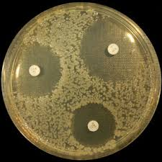

Slide 7
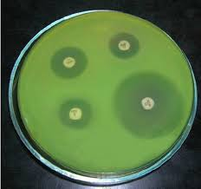

Slide 8
Methodology
Prepare Muller – Hinton agar (prepared according to FDA) as the best media for the growth of most types of pathogenic bacteria.
1- The media is cultured by the bacteria under test in sterile condition (by streaking or swabbing method).
2- After a drying of inoculum, and by using sterile forceps (sterilized by alcohol), the discs are putted on the medium surface but (not more than 6disc).
3- Incubated at 37C for 18hr. (not more than 24 hr) .
4- The inhibition zone measured by mm. around each disc.

Slide 9
