Slide 1
Epidemiology
Dr Dhabyia ihsan
Dr Abd elwahab Al shekhly
2020-2021

Slide 2
By definition, epidemiology is the study (scientific, systematic, and data-driven) of the distribution (frequency, pattern) and determinants (causes, risk factors) of health-related states and events (not just diseases) in specified populations (neighborhood, school, city, state, and country, global).
Epidemiology is the study and analysis of the distribution (who, when, and where), patterns and determinants of health and disease conditions in defined populations.
Beside above, what does distribution mean in epidemiology? In the definition of epidemiology, “distribution” refers to descriptive epidemiology, while “determinants” refers to analytic epidemiology. So “distribution” covers time (when), place (where), and person (who), whereas “determinants” covers causes, risk factors, modes of transmission (why and how).Just so, what is traditional epidemiology.

Slide 3
The goal of epidemiology is to establish causal factors for health issues in order to improve the health and safety of entire populations.
A population can refer to a town, country, age group, or race.
Health issues refer to anything that might impact health in the present or future.
Often, however, epidemiology provides sufficient evidence to take appropriate control and prevention measures. Epidemiologic studies fall into two categories: experimental and observational.

Slide 4
The objectives of epidemiology include the following:
To identify the etiology or cause of disease.
To determine the extent of disease.
To study the progression of disease.
To evaluate preventive and therapeutic measures for a disease or condition.
To develop public health policy.

Slide 5
Components of epidemiological study
Frequency refers not only to the number of health events such as the number of cases of meningitis or diabetes in a population, but also to the relationship of that number to the size of the population. The resulting rate allows epidemiologists to compare disease occurrence across different populations.
Disease frequency is measures in terms of rate and ratios which they used for comparing disease frequency in different populations or subgroups of the same population.
Study distribution of diseases Epidemiology detects the causal association between a disease & person characteristics or a factor in its environment, since these factors have different value in different occasions, so they are called variables (epidemiologic variables) which are studied to detect people at risk to develop an outcome and to have clues to etiology of the event or predict or to have predictive values about it. After analyzing such variable using suitable epidemiologic triangle, we conduct, form and test hypothesis concerning agent, source, and mode of transmission.

Slide 6
Epidemiologic triangle:
is a unique combination of events resulting in disease. Types:
Time patterns may be annual, seasonal, weekly, daily, hourly, weekday versus weekend, or any other breakdown of time that may influence disease or injury occurrence.
Place patterns include geographic variation, urban/rural differences, and location of work sites or schools.
Personal characteristics include demographic factors which may be related to risk of illness, injury, or disability such as Age: it is the most important epidemiologic variable in describing occurrence & distribution of the disease due to the influence upon the potential of exposure, level of immunity & resistance, and physiologic response at tissue level which reflects disease manifestations.
E.g. susceptibility for infections varies with age.
, sex, marital status, and socioeconomic status, as well as behaviors and environmental exposures.

Slide 7
Study of Determinants of disease:
Determinant: is an attribute or circumstance that affects the liability of an individual to be exposed to or, when exposed, to develop disease (e.g. hereditary predisposition, environmental condition).
/ How does the disease occur? It is determined by the following:
1- Susceptibility: it is the liability of a person to develop an outcome.
2- Exposure to a biological, physical or chemical agent.
Determinant of disease
AGENT, HOST AND ENVIRONMENT: this model is suitable for infectious diseases, but is not confined to them.
a. HOST (susceptible host): susceptibility and immunity
b. AGENT (harmful agent): biologic, physical or chemical.
Physical: heat, light, vibration, noise & objects.
Chemical: nutritive, poisons, drugs & allergens.
Energy: ionizing radiation.
Biologic: micro-organisms.
Suitable inoculum size, proper route of entry & serotype/strain and eradication of the agent are important to put in mind for biologic agents.

Slide 8
ENVIRONMENT (proper environment): physical (temperature, humidity, altitude,), chemical, biological (harboring the agent or its vector) and the socioeconomic status (TB in low SES from malnutrition and overcrowding).
Uses of Epidemiology
Count health-related events.
Describe the distribution of health-related events in the population.
Describe clinical patterns.
Identify risk factors for developing diseases.
Identify causes or determinants of disease.
Identify control and/or preventive measures.

Slide 9
Essential definitions in epidemiology
Cause: is an event, characteristic or condition that precedes the disease and without which the disease could not have occurred.
The event may be exposure to: a microbe, chemical substance, physical trauma, radiation, etc.
Many diseases do not have a single cause and thus exposure to a ‘causal agent’ does not inevitably result in disease, e.g. ca lung & IHD.
Risk factor: any attribute, characteristic, or exposure of an individual which increases the likelihood of developing a disease.
Population at Risk: are people who are liable to develop an outcome (disease, death,), e.g. an outbreak of diphtheria in a primary school, we cannot put all the students as population at risk, but we exclude those infected before as they will not develop the disease anymore.

Slide 10
Basic measurements in epidemiology:
The morbidity rate is the frequency or proportion with which a disease appears in a population.
Sources of morbidity data:
1. Hospital records;
Advantages: give demographic characteristics (age, gender,)
Given the nature of illness (clinical features, investigations…)
Limitations: hospital cases represent the tip of the iceberg.
Hospital records are not designed for research purposes.
2. Others: private and public clinics, insurance companies, prison records...
Types of morbidity rates
INCIDENCE RATE (Absolute Risk): is the rate of new cases occurrence (X) among population at risk (Y) in a specified time period. It measure population at risk during the same time
I = [ X / Y ] . K
USES:
• identify population at risk
• In researches to study disease etiology (to detect etiologic agents that cause the disease)
• In planning for preventive measures; as to prepare resources to combat events those occur in short periods and non-lasting for a long time (measles, meningitis…)

Slide 12
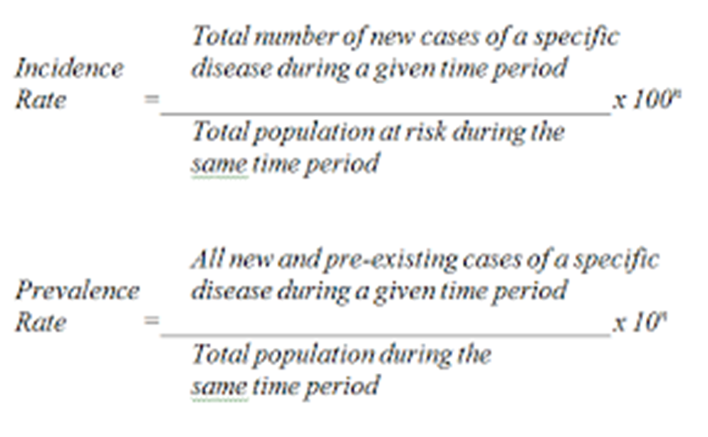
PREVALENCE (P) RATE: the rate of all cases (new and old) of an illness in a population at risk in a time period, and this period

Slide 13
Mortality rate, or death rate is a measure of the number of deaths (in general, or due to a specific cause) in a particular population, scaled to the size of that population, per unit of time. Mortality rate is typically expressed in units of deaths per 1,000 individuals per year.

Slide 14
MATHMATICAL RELATIONSHIPS between numerator and denominator expressed depending on:
• PROPORTION: numerator is a part of the denominator, and the denominator is either
1.Not represent the population at risk; then it is simple proportion, as in: Female proportion in the population= F / (F+M)
Proportionate Mortality= specific deaths / total deaths
Incidence in a group sharing a certain factor = cases / total
2.Represent the population at risk with a time unit or interval; then it is a RATE, as in:
Incidence = new cases / population at risk in time interval
Prevalence = (new + old cases) / population at risk in time interval
3. Represent the population at risk but without a time unit; named rates but they are not true rates.
a) Denominator here represents those who are specifically susceptible, as in
Case Fatality Rate = [deaths / total cases] * 100
b) Denominator here represents those who are not necessary susceptible but cluster in &/or place &/or special occasion or situation, as in food poisoning
Attack Rate = cases / no. of those shared the condition

Slide 15
RATIO: numerator is not necessary a part of the denominator (a proportion can be a ratio but a ratio not necessary to be a proportion)
Epidemiological studies
Are aimed, where possible, at revealing unbiased relationships between exposures such as alcohol or smoking, biological agents, stress, or chemicals to mortality or morbidity.
The identification of causal relationships between these exposures and outcomes is an important aspect of epidemiology. Modern epidemiologists use informatics as a tool.
Epidemiologists employ a range of study designs from the observational to experimental and generally categorized as
a- observational study include:
1-Descriptive,
2-analytic (aiming to further examine known associations or hypothesized relationships),
In observational studies, nature is allowed to "take its course," as epidemiologists observe from the sidelines. Conversely, in experimental studies, the epidemiologist is the one in control of all of the factors entering a certain case study

Slide 16
Observational studies have two components,
Descriptive and analytical.
Descriptive observations pertain to the "who, what, where and when of health-related state occurrence". However, analytical observations deal more with the ‘how’ of a health-related event such as
Cross –sectional study
Longitudinal study
Analytical study such as
Case control study
Cohort study
Ecological studies (correlational study)
B-experimental (a term often equated with clinical or community trials of treatments and other interventions).
Experimental epidemiology contains three case types:
Randomized controlled trials (often used for new medicine or drug testing)
Field trials (conducted on those at a high risk of contracting a disease), and
Community trials (research on social originating diseases).

Slide 18
Thank you
ByDr-dhabyia ihsan
2020-202

