Slide 1
Numbering Systems
First Year / Digital Electronics
Department Of Computer Engineering Techniques

Slide 2
Decimal Numbering System
How is a positive integer represented in decimal?
Let’s analyze the decimal number 375:
  375 = (3 x 100) + (7 x 10) + (5 x 1)
  = (3 x 10²) + (7 x 10¹) + (5 x 10⁰)
Position weights
10²
10¹
10⁰
Number digits
3
7
5
5 x10⁰ = 5
+
7 x10¹ = 70
+
3 x 10² = 300
375

Slide 3
Decimal System Principles
A decimal number is a sequence of digits
Decimal digits must be in the set: {0, 1, 2, 3, 4, 5, 6, 7, 8, 9} (Base 10)
Each digit contributes to the value the number represents
The value contributed by a digit equals the product of the digit times the weight of the position of the digit in the number

Slide 4
Decimal System Principles
Position weights are powers of 10
The weight of the rightmost (least significant digit) is 10⁰ (i.e.1)
The weight of any position is 10^{x}, where x is the number of positions to the right of the least significant digit
Position weights
10⁴
10³
10²
10¹
10⁰
digits
3
7
5

Slide 5
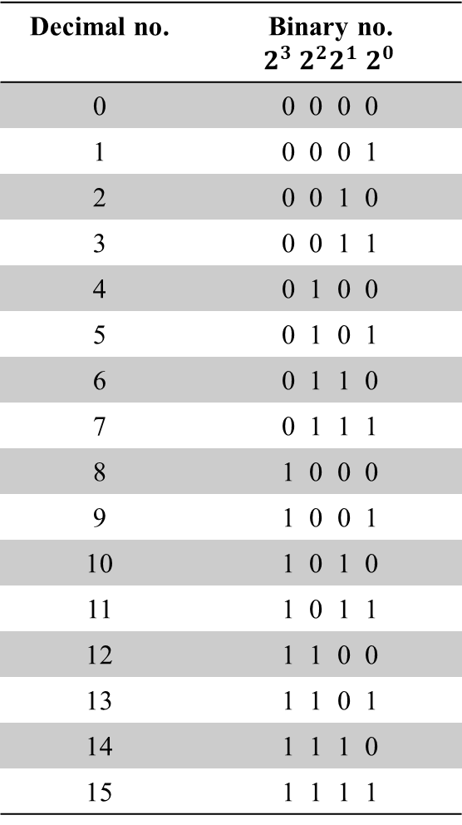
Decimal no. | Binary no. $$2^{3} 2^{2}2^{1} 2^{0}$$
0 | 0 0 0 0
1 | 0 0 0 1
2 | 0 0 1 0
3 | 0 0 1 1
4 | 0 1 0 0
5 | 0 1 0 1
6 | 0 1 1 0
7 | 0 1 1 1
8 | 1 0 0 0
9 | 1 0 0 1
10 | 1 0 1 0
11 | 1 0 1 1
12 | 1 1 0 0
13 | 1 1 0 1
14 | 1 1 1 0
15 | 1 1 1 1
Table shows the decimal numbers representation in Binary numbers

Slide 6
Binary Numbering System
So in a computer, the only possible digits we can use to encode data are {0,1}
  The numbering system that uses this set of digits is the base 2 system (also called the Binary Numbering System)
We can apply all the principles of the base 10 system to the base 2 system
Position weights
2⁴
2³
2²
2¹
2⁰
digits
1
0
1
1

Slide 7
Binary Numbering System
How is a positive integer represented in binary?
Let’s analyze the binary number 110:
  110 = (1 x 2²) + (1 x 2¹) + (0 x 2⁰)
  = (1 x 4) + (1 x 2) + (0 x 1)
Position weights
2²
2¹
2⁰
Number digits
1
1
0
0 x2⁰ = 0
+
1 x2¹ = 2
+
1 x 2² = 4
6
So a count of SIX is represented in binary as 110

Slide 8
Binary to Decimal Conversion
To convert a base 2 (binary) number to base 10 (decimal):
  Add all the values (positional weights) where a one digit occurs
  Positions where a zero digit occurs do NOT add to the value, and can be ignored

Slide 9
Binary to Decimal Conversion
Example1: Convert binary 100101 to decimal
(written 1 0 0 1 0 1₂ ) =
1*2⁰ +
0*2¹ +
1*2² +
0*2³ +
0*2⁴ +
1*2⁵
1 +
4 +
32 +
(37)₁₀

Slide 10
Binary to Decimal Conversion
Example 2: (10111) ₂
positional powers of 2: 2⁴ 2³ 2² 2¹ 2⁰
decimal positional value: 16 8 4 2 1
binary number: 1 0 1 1 1
16 + 4 + 2 + 1 = (23) ₁₀

Slide 11
Binary to Decimal Conversion
Example 3: (110010) ₂
positional powers of 2: 2⁵ 2⁴ 2³ 2² 2¹ 2⁰
decimal positional value: 32 16 8 4 2 1
binary number: 1 1 0 0 1 0
32 + 16 + 2 = (50) ₁₀

Slide 12
Decimal to Binary Conversion
The Division Method:
1) Start with your number (call it N) in base 10
2) Divide N by 2 and record the remainder
3) If (quotient = 0) then stop, else make the quotient your new N, and go back to step 2
The remainders comprise your answer, starting with the last remainder as your first (leftmost) digit.
In other words, divide the decimal number by 2 until you reach zero, and then collect the remainders in reverse.

Slide 13
Decimal to Binary Conversion
Using the Division Method:
Divide decimal number by 2 until you reach zero, and then collect the remainders in reverse.
Example 4: (22) ₁₀ =
2 ) 22 Rem:
2 ) 11 0
2 ) 5 1
2 ) 2 1
2 ) 1 0
0 1
(10110) ₂

Slide 14
Decimal to Binary Conversion
Using the Division Method
Example 5: (56) ₁₀ =
2 ) 56 Rem:
2 ) 28 0
2 ) 14 0
2 ) 7 0
2 ) 3 1
2 ) 1 1
0 1
(111000) ₂

Slide 15
Decimal to Binary Conversion
The Subtraction Method:
Subtract out largest power of 2 possible (without going below zero), repeating until you reach 0.
  Place a 1 in each position where you COULD subtract the value
  Place a 0 in each position that you could NOT subtract out the value without going below zero.

Slide 16
Decimal to Binary Conversion
Example 6: (21) ₁₀
21 2⁶ 2⁵ 2⁴ 2³ 2² 2¹ 2⁰
64 32 16 8 4 2 1
0 1
- 1
0
0 1
- 4
1
- 16
5 1
Answer: (21) ₁₀ = (10101) ₂

Slide 17
Decimal to Binary Conversion
Example 7: (56) ₁₀
56 2⁶ | 2⁵ 2⁴ 2³ 2² 2¹ 2⁰
- 32 64| 32 16 8 4 2 1
24 | 1 1 1 0 0 0
- 16
8
- 8 Answer: (56) ₁₀ = (111000) ₂
0

Slide 18
Octal Numbering System
Base: 8
Digits: 0, 1, 2, 3, 4, 5, 6, 7
Octal number: (357) ₈
= (3 x 8² ) + (5 x 8¹) + (7 x 8⁰)
To convert to base 10, beginning with the rightmost digit, multiply each nth digit by 8^{(n-1)}, and add all of the results together.

Slide 19
Octal to Decimal Conversion
Example 8: (357) ₈
positional powers of 8: 8² 8¹ 8⁰
decimal positional value: 64 8 1
Octal number: 3 5 7
(3 x 64) + (5 x 8) + (7 x 1)
= 192 + 40 + 7 = (239) ₁₀

Slide 20
Octal to Decimal Conversion
Example 9: (1246) ₈
positional powers of 8: 8³ 8² 8¹ 8⁰
decimal positional value: 512 64 8 1
Octal number: 1 2 4 6
(1 x 512) + (2 x 64) + (4 x 8) + (6 x 1)
= 512 + 128 + 32 + 6 = (678) ₁₀

Slide 21
Decimal to Octal Conversion
The Division Method:
1) Start with your number (call it N) in base 10
2) Divide N by 8 and record the remainder
3) If (quotient = 0) then stop
  else make the quotient your new N, and go back to step 2
The remainders comprise your answer, starting with the last remainder as your first (leftmost) digit.
In other words, divide the decimal number by 8 until you reach zero, and then collect the remainders in reverse.

Slide 22
Decimal to Octal Conversion
Using the Division Method:
Example 10: (214) ₁₀ =
8 ) 214 Rem:
8 ) 26 6
8 ) 3 2
0 3
(326) ₈

Slide 23
Decimal to Octal Conversion
Example 11: (4330) ₁₀ =
8 ) 4330 Rem:
8 ) 541 2
8 ) 67 5
8 ) 8 3
8 ) 1 0
0 1
(10352) ₈

Slide 24
Hexadecimal (Hex) Numbering System
Base: 16
Digits: 0, 1, 2, 3, 4, 5, 6, 7, 8, 9, A, B, C, D, E, F
Hexadecimal number: (1F4) ₁₆
= (1 x 16² ) + (F x 16¹) + (4 x 16⁰)

Slide 25
Hexadecimal (Hex) Extra Digits
Decimal Value Hexadecimal Digit
10 A
11 B
12 C
13 D
14 E
15 F

Slide 26
Hex to Decimal Conversion
To convert to base 10:
  Begin with the rightmost digit
  Multiply each nth digit by 16^{(n-1)}
  Add all of the results together

Slide 27
Hex to Decimal Conversion
Example 14: (1F4) ₁₆
positional powers of 16: 16³ 16² 16¹ 16⁰
decimal positional value: 4096 256 16 1
Hexadecimal number: 1 F 4
(1 x 256) + (F x 16) + (4 x 1)
= (1 x 256) + (15 x 16) + (4 x 1)
= 256 + 240 + 4 = (500) ₁₀

Slide 28
Hex to Decimal Conversion
Example 15: (25AC) ₁₆
positional powers of 16: 16³ 16² 16¹ 16⁰
decimal positional value: 4096 256 16 1
Hexadecimal number: 2 5 A C
(2 x 4096) + (5 x 256) + (A x 16) + (C x 1)
= (2 x 4096) + (5 x 256) + (10 x 16) + (12 x 1)
= 8192 + 1280 + 160 + 12 = (9644) ₁₀

Slide 29
Decimal to Hex Conversion
The Division Method:
1) Start with your number (call it N) in base 10
2) Divide N by 16 and record the remainder
3) If (quotient = 0) then stop
  else make the quotient your new N, and go back to step 2
The remainders comprise your answer, starting with the last remainder as your first (leftmost) digit.
In other words, divide the decimal number by 16 until you reach zero, and then collect the remainders in reverse.

Slide 30
Decimal to Hex Conversion
Using The Division Method:
Example 1: (126) ₁₀ =
16) 126 Rem:
16) 7 14 = E
0 7
(7E) ₁₆

Slide 31
Decimal to Hex Conversion
Example 16: (603) ₁₀ =
16) 603 Rem:
16) 37 11 = B
16) 2 5
0 2
(25B)₁₆

Slide 32
Binary to Octal Conversion
The maximum value represented in 3 bit is: 2³ – 1 = 7
So using 3 bits we can represent values from 0 to 7 which are the digits of the Octal numbering system.
Thus, three binary digits can be converted to one octal digit.

Slide 33
Binary to Octal Conversion
Three-bit Group Decimal Digit Octal Digit
000 0 0
001 1 1
010 2 2
011 3 3
100 4 4
101 5 5
110 6 6
111 7 7

Slide 34
Octal to Binary Conversion
Example 19: Convert (742) ₈ to binary
Convert each octal digit to 3 bits:
7 = 111
4 = 100
2 = 010
111 100 010
(742) ₈ = (111100010) ₂

Slide 35
Binary to Octal Conversion
Example 20:
Convert (10100110) ₂ to Octal
Starting at the right end, split into groups of 3:
10 100 110 →
110 = 6
100 = 4
010 = 2 (pad empty digits with 0)
(10100110) ₂ = (246) ₈

Slide 36
Binary to Hex Conversion
The maximum value represented in 4 bit is: 2⁴ – 1 = 15
So using 4 bits we can represent values from 0 to 15 which are the digits of the Hexadecimal numbering system.
Thus, four binary digits can be converted to one hexadecimal digit.

Slide 37
Binary to Hex Conversion
Four-bit Group Decimal Digit Hexadecimal Digit
0000 0 0
0001 1 1
0010 2 2
0011 3 3
0100 4 4
0101 5 5
0110 6 6
0111 7 7
1000 8 8
1001 9 9
1010 10 A
1011 11 B
1100 12 C
1101 13 D
1110 14 E
1111 15 F

Slide 38
Binary to Hex Conversion
Example 21:
Convert (110100110) ₂ to Hex
Starting at the right end, split into groups of 4 bits:
1 1010 0110 →
0110 = 6
1010 = A
0001 = 1 (pad empty digits with 0)
(110100110) ₂ = (1A6) ₁₆

Slide 39
Hex to Binary Conversion
Example 21:
Convert (3D9) ₁₆ to Binary
Convert each hex digit to its 4 bits binary as follows:
3 = 0011
D = 1101
9 = 1001
0011 1101 1001 →
(3D9) ₁₆ = (1111011001) ₂ (can remove leading zeros)

Slide 40
Conversion between Binary and Hex - Try It Yourself
Convert the following numbers:
  (1010111101) ₂ to Hex
  (82F) ₁₆ to Binary
(Answers on NEXT page)

Slide 41
Answers
(1010111101) ₂ → 10 1011 1101 = (2BD) ₁₆
(82F) ₁₆ = 0100 0010 1111 → (10000101111) ₂

Slide 42
Hex to Octal Conversion
Example 21:
Convert (E8A) ₁₆ to Octal
First convert the Hex to binary we get:
1110 1000 1010
(1110 1000 1010) ₂
111 010 001 010 and re-group by 3 bits(starting on the right)
Then convert the binary to octal:
7 2 1 2
So (E8A) ₁₆ = (7212) ₈

Slide 43
Octal to Hex Conversion
Example 21:
Convert 752₈ to Hex
First convert the octal to binary we get:
(111 101 010) ₂
0001 1110 1010 re-group by 4 bits (add leading zeros)
Then convert the binary to hex:
1 E A
So (752) ₈ = (1EA) ₁₆

Slide 44
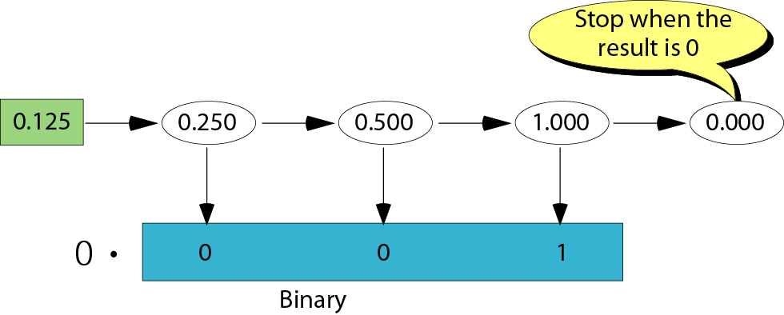




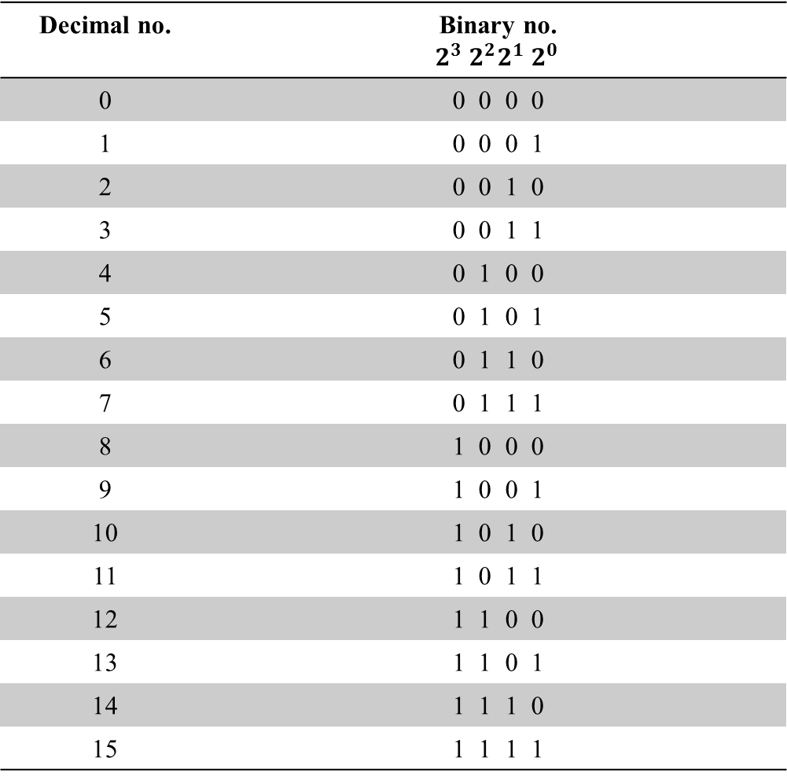
Convert Decimal fractions to binary
Example 22:
$$Integer$$
0
0
1
$$0.125 ∗2=0.250$$
$$=0.001$$
$$0.25 ∗2=0.50$$
$$0. 5 ∗2=1.0$$

Slide 45

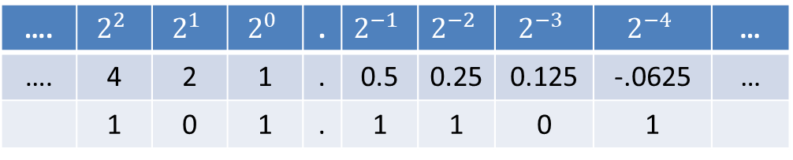

Convert Binary fractions to Decimal
Example 23:
$${(101.1101) }_{2}={( ? ) }_{10}$$
…. | $$2^{2}$$ | $$2^{1}$$ | $$2^{0}$$ | . | $$2^{−1}$$ | $$2^{−2}$$ | $$2^{−3}$$ | $$2^{−4}$$ | …
…. | 4 | 2 | 1 | . | 0.5 | 0.25 | 0.125 | -.0625 | …
 | 1 | 0 | 1 | . | 1 | 1 | 0 | 1
$$=4+1+0.5+0.25+0.0625=5.8125$$
$${(101.1101) }_{2}={(5.8125) }_{10}$$

Slide 46

Convert Hex. to Octal
Example 24:
$${\text{(}\text{4}\text{E}\text{0}\text{C}\text{.}\text{69}\text{A}\text{7}) }_{Hex}={ ( ? )}_{Octal}$$
First convert the hex to binary:
and re-group by 3 bits (starting on the right)
and re-group by 3 bits (starting on the left)
0100 1110 0000 1100 . 0110 1001 1010 011100
4 7 0 1 4 . 3 2 3 2 3 4
$${\text{(}\text{4}\text{E}\text{0}\text{C}\text{.}\text{69}\text{A}\text{7}) }_{Hex}={ ( 47014.323234)}_{Octal}$$

Slide 47

Convert Octal to Hex.
H.W:
$${(?.?) }_{Octal}=({?.?)}_{ Hex}$$

