Slide 1
كلية الرشيد الجامعة
قسم تقنيات التحليلات المرضية
Cell Life Cycle
د. حسين الشريف
المحاظرة الحاديه عشر والثانية عشر والثالثه عشر

Slide 2
Introduction
Have you ever watched a caterpillar turn into a butterfly? If so, you’re probably familiar with the idea of a life cycle. Butterflies go through some fairly spectacular life cycle transitions—turning from something that looks like a lowly worm into a glorious creature that floats on the breeze. Other organisms, from humans to plants to bacteria, also have a life cycle: a series of developmental steps that an individual goes through from the time it is born until the time it reproduces.
The cell cycle can be thought of as the life cycle of a cell. In other words, it is the series of growth and development steps a cell undergoes between its “birth”—formation by the division of a mother cell—and reproduction—division to make two new daughter cells.

Slide 3
Stages of the cell cycle
To divide, a cell must complete several important tasks: it must grow, copy its genetic material (DNA), and physically split into two daughter cells. Cells perform these tasks in an organized, predictable series of steps that make up the cell cycle. The cell cycle is a cycle, rather than a linear pathway, because at the end of each go-round, the two daughter cells can start the exact same process over again from the beginning.
In eukaryotic cells, or cells with a nucleus, the stages of the cell cycle are divided into two major phases: interphase and the mitotic (M) phase.
During interphase, the cell grows and makes a copy of its DNA.
During the mitotic (M) phase, the cell separates its DNA into two sets and divides its cytoplasm, forming two new cells.

Slide 4
Interphase
Let’s enter the cell cycle just as a cell forms, by division of its mother cell. What must this newborn cell do next if it wants to go on and divide itself? Preparation for division happens in three steps:
G1 phase , also called the first gap phase, the cell grows physically larger, copies organelles, and makes the molecular building blocks it will need in later steps. [Do cells always grow before they divide?]

Slide 5
S phase. In S phase, the cell synthesizes a complete copy of the DNA in its nucleus. It also duplicates a microtubule-organizing structure called the centrosome. The centrosomes help separate DNA during M phase.
G2 phase. During the second gap phase, the cell grows more, makes proteins and organelles, and begins to reorganize its contents in preparation for mitosis. G2 phase ends when mitosis begins.
The G1,S and G2 phases together are known as interphase. The prefix inter- means between, reflecting that interphase takes place between one mitotic (M) phase and the next.

Slide 6
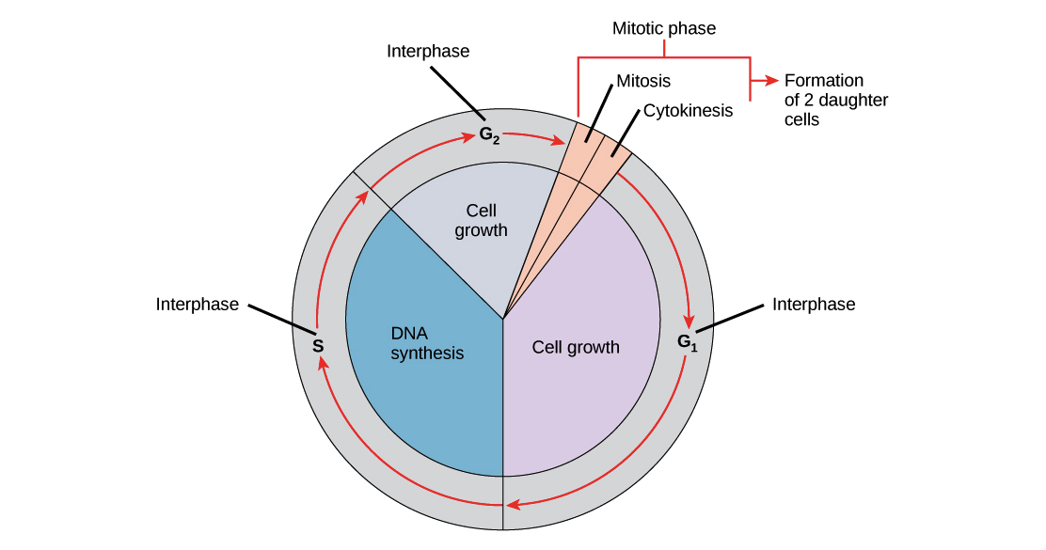
M phase
During the mitotic (M) phase, the cell divides its copied DNA and cytoplasm to make two new cells. M phase involves two distinct division-related processes: mitosis and cytokinesis.
In mitosis, the nuclear DNA of the cell condenses into visible chromosomes and is pulled apart by the mitotic spindle,
a specialized structure made out of microtubules. Mitosis takes place in four stages: prophase (sometimes divided into early prophase and prometaphase), metaphase, anaphase, and telophase. You can learn more about these stages in the video on mitosis.
In cytokinesis, the cytoplasm of the cell is split in two, making two new cells. Cytokinesis usually begins just as mitosis is ending, with a little overlap. Importantly, cytokinesis takes place differently in animal and plant cells.

Slide 7
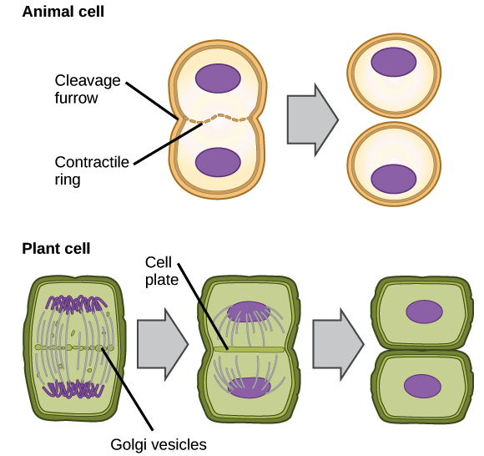
In animals, cell division occurs when a band of cytoskeletal fibers called the contractile ring contracts inward and pinches the cell in two, a process called contractile cytokinesis. The indentation produced as the ring contracts inward is called the cleavage furrow. Animal cells can be pinched in two because they’re relatively soft and squishy.
Plant cells are much stiffer than animal cells; they’re surrounded by a rigid cell wall and have high internal pressure. Because of this, plant cells divide in two by building a new structure down the middle of the cell. This structure, known as the cell plate, is made up of plasma membrane and cell wall components delivered in vesicles, and it partitions the cell in two.

Slide 8
What is mitosis?
Mitosis is a type of cell division in which one cell (the mother) divides to produce two new cells (the daughters) that are genetically identical to itself. In the context of the cell cycle, mitosis is the part of the division process in which the DNA of the cell's nucleus is split into two equal sets of chromosomes.
Mitosis is used for almost all of your body’s cell division needs. It adds new cells during development and replaces old and worn-out cells throughout your life. The goal of mitosis is to produce daughter cells that are genetically identical to their mothers, with not a single chromosome more or less.
Meiosis, on the other hand, is used for just one purpose in the human body: the production of gametes—sex cells, or sperm and eggs. Its goal is to make daughter cells with exactly half as many chromosomes as the starting cell.

Slide 9
Phases of meiosis
In many ways, meiosis is a lot like mitosis. The cell goes through similar stages and uses similar strategies to organize and separate chromosomes. In meiosis, however, the cell has a more complex task. It still needs to separate sister chromatids (the two halves of a duplicated chromosome), as in mitosis. But it must also separate homologous chromosomes, the similar but no identical chromosome pairs an organism receives from its two parents.
Meiosis I
Before entering meiosis I, a cell must first go through interphase. As in mitosis, the cell grows during G1 phase, copies all of its chromosomes during S phase, and prepares for division during G2 phase.

Slide 10
During prophase I, differences from mitosis begin to appear. As in mitosis, the chromosomes begin to condense, but in meiosis I, they also pair up. Each chromosome carefully aligns with its homologue partner so that the two match up at corresponding positions along their full length. For instance, in the image below, the letters A, B, and C represent genes found at particular spots on the chromosome, with capital and lowercase letters for different forms, or alleles, of each gene. The DNA is broken at the same spot on each homologue—here, between genes B and C—and reconnected in a crisscross pattern so that the homologues exchange part of their DNA.

Slide 11
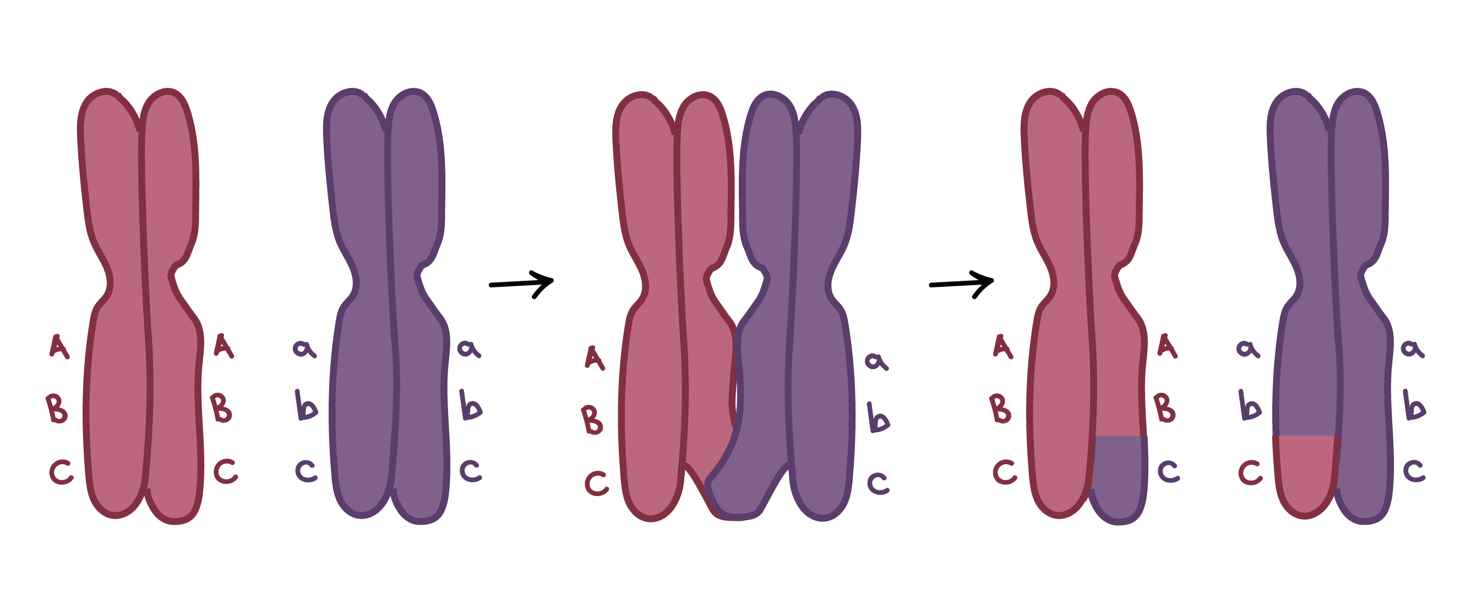
This process, in which homologous chromosomes trade parts, is called crossing over. It's helped along by a protein structure called the synaptonemal complex that holds the homologues together. The chromosomes would actually be positioned one on top of the other—as in the image below—throughout crossing over; they're only shown side-by-side in the image above so that it's easier to see the exchange of genetic material.

Slide 12
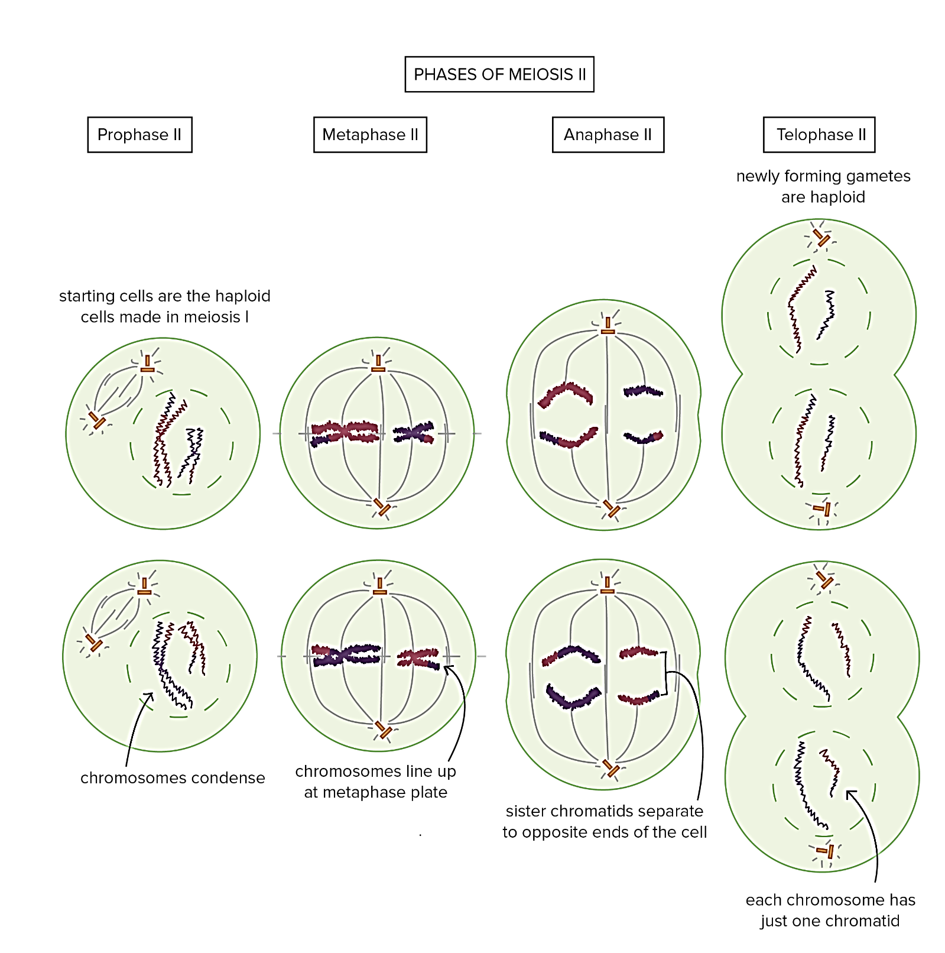
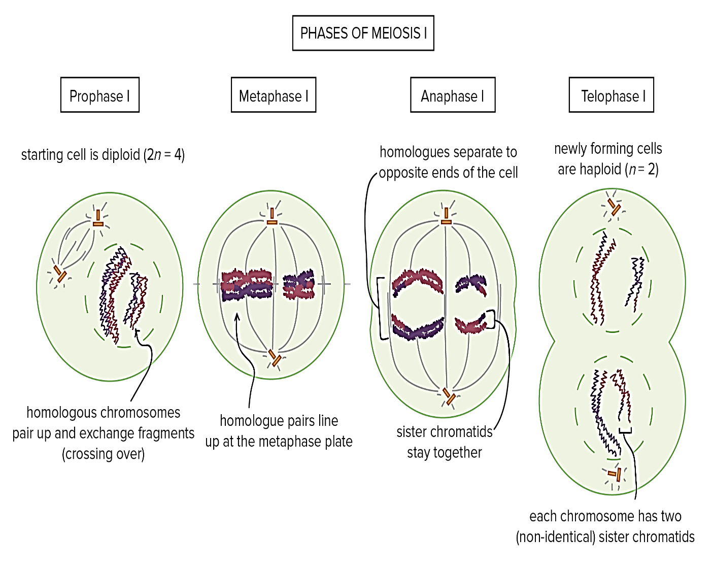

Slide 13
Spermatogenesis and Oogenesis in Humans
Spermatogenesis is the production of sperm in males.
1- In the testes of human males, primary spermatocytes, which are diploid (2n), divide during the first meiotic division to form two secondary spermatocytes, which are haploid (n).
2- Secondary spermatocytes divide during the second meiotic division to produce four spermatids which are also haploid (n).
3- Spermatids mature into sperm (spermatozoa).
In human males, sperm have 23 chromosomes, which is the haploid number. The process of meiosis in males always results in four cells that become sperm.

Slide 14

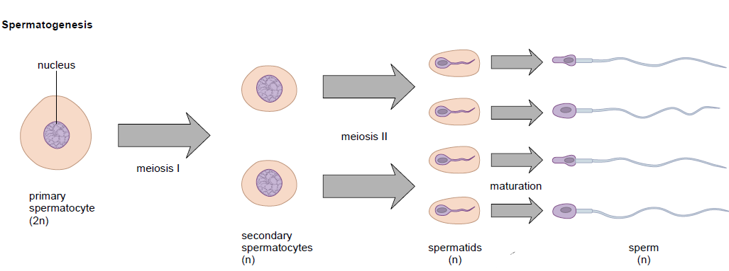

Slide 15
oogenesis is the production of eggs in females.
1- In ovaries of human females, a primary oocyte, which is diploid (2n), divides during the first meiotic division into two cells, each of which is haploid but the chromosomes are duplicated. One of these cells, termed the secondary oocyte, receives almost all the cytoplasm. The other is a polar body.
2- A polar body is a nonfunctioning cell that occurs during oogenesis. It contains little cytoplasm and will eventually disintegrate.
3- The secondary oocyte begins the second meiotic division but stops at metaphase II.

Slide 16
4- The secondary oocyte leaves the ovary and enters an oviduct where it may be approached by a sperm.
5- If a sperm does enter the oocyte, the oocyte is activated to complete the second meiotic division. The mature egg has 23 chromosomes, each consisting of one chromatid.
- In human females, meiosis produces only one egg and two polar bodies.

Slide 17
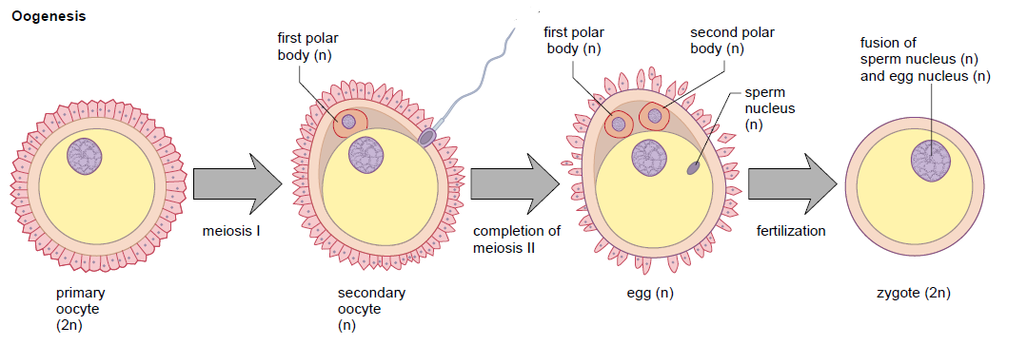

Slide 18
Definition of Gene
The basic physical unit of heredity; a linear sequence of nucleotides along a segment of DNA that provides the coded instructions for synthesis of RNA, which, when translated into protein, leads to the expression of hereditary character. Every person has two copies of each gene, one inherited from each parent.
Genetic code
The genetic code is the set of rules by which information encoded in genetic material (DNA or RNA sequences) is translated into proteins (amino acid sequences) by living cells.

Slide 19
Gene Theory
The Gene Theory is one of the basic principles of biology. The main concept of this theory is that traits are passed from parents to offspring through gene transmission.
Genes are located on chromosomes and consist of DNA. They are passed from parent to offspring through reproduction.
The principles that control heredity were introduced by a Gregor Mendel in the 1860’s (known as the “father of modern genetics”). These principles are now called Mendel's law of segregation and law of independent assortment.

Slide 20
Gene Action
Gene action: refers to the way in which certain genes exert their effects on the body. A combination of such gene actions results in the observable phenotype of an organism.
Gene Action: refers to the behavior or mode of expression of genes in a genetic populations.
Gene Action was first studied by Archibald Edward Garrod (1902) in man and subsequently by other in smaller organisms like Drosophila , and Bacteria.
There are three broad types of gene actions:
Additive gene action.
Dominance gene action.
Epistatic gene action.

Slide 21
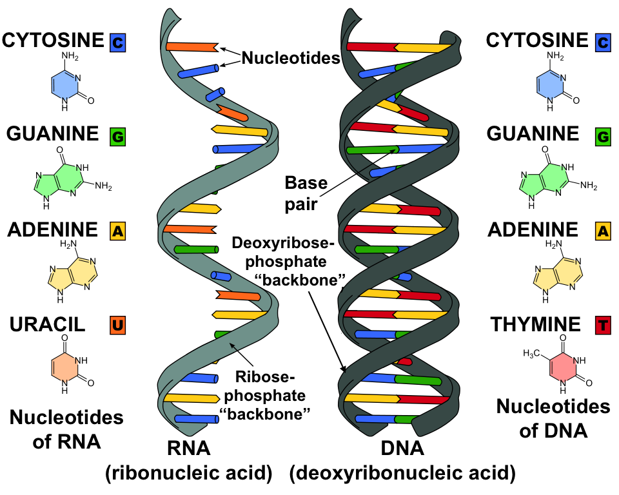
DNA and RNA Structure and Function
For life on Earth, DNA (deoxyribonucleic acid) is the genetic material. DNA is organized into structures called chromosomes. In eukaryotic cells, including those of humans, the majority of the DNA is located in the nucleus. A small amount of DNA is also found in the mitochondria, but for this chapter we will focus on the nuclear DNA. Genetic material must be able to do three things:
replicate so that it can be transmitted to the next generation.
(2) store information.
(3) undergo change (mutation) to provide genetic variability. DNA meets all three of these criteria.

Slide 23
Summary Features of DNA and RNA
 | DNA | RNA
Function | Repository of genetic information | Involved in protein synthesis and gene regulation; carrier of genetic information in some viruses
Sugar | Deoxyribose | Ribose
Structure | Double helix | Usually single-stranded
Bases | C, T, A, G | C, U, A, G

Slide 24
Replication of DNA
When cells divide, each new cell gets an exact copy of DNA. The process of copying a DNA helix is called DNA replication. During the S phase of interphase during mitosis when DNA is replicated, the double-stranded structure of DNA allows each original strand to serve as a template (mold) for the formation of a complementary new strand. DNA replication is termed semiconservative because each new double helix has one original strand and one new strand. In other words, one of the original strands is conserved, or present, in each new double helix. Each original strand has produced a new strand through complementary base pairing, so there are now two DNA helices identical to each other and to the original molecule shows how complementary nucleotides pair in the daughter strand.
1. Before replication begins, the two strands that make up parental DNA are hydrogen-bonded to each other.
2. An enzyme (DNA helicase) unwinds and “unzips” double stranded DNA (i.e., the weak hydrogen bonds between the paired bases break).
3. New complementary DNA nucleotides (composed of a sugar, phosphate, and one nitrogen-containing base), always present in the nucleus, fi t into place by the process
of complementary base pairing. These are positioned and joined by the enzyme DNA polymerase.
4. To complete replication, the enzyme ligase seals any breaks in the sugar–phosphate backbone. The DNA returns to its coiled structure.
5. The two double-helix molecules are identical to each other and to the original DNA molecul

Slide 25
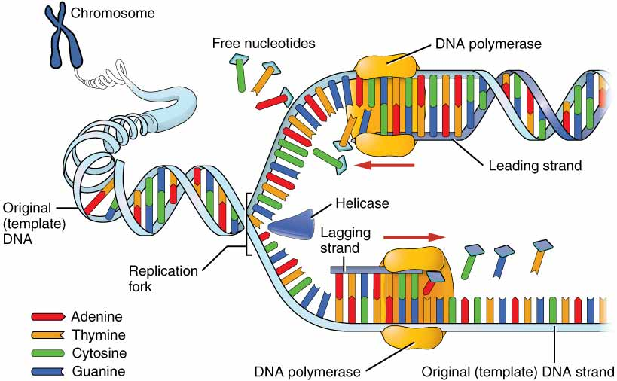

Slide 26
The Structure and Function of RNA
RNA (ribonucleic acid)is made up of nucleotides containing the sugar ribose. This sugar accounts for the scientific name of this polynucleotide. The four nucleotides that make up the RNA molecule have the following bases: adenine (A), uracil (U), cytosine (C), and guanine (G) One of the differences
between RNA and DNA is the replacement of thymine with uracil. As with DNA, complementary base pairing may occur
Messenger RNA
Messenger RNA (mRNA) is produced in the nucleus, where DNA serves as a template for its formation. This type of RNA carries genetic information from DNA to the ribosomes in the cytoplasm, where protein synthesis occurs. Messenger RNA is a linear molecule, as shown in.
Ribosomal RNA
In eukaryotes, ribosomal RNA (rRNA)is produced using a DNA template in the nucleolus of the nucleus. Ribosomal RNA joins with specific proteins to form the large and small subunits of ribosomes. The subunits then leave the nucleus and either attach themselves to the endoplasmic reticulum or remain free within the cytoplasm. During the process of protein synthesis, the large and small ribosomal subunits combine to form a complex (the ribosome) that acts as a workbench for the manufacture of proteins.
Transfer RNA
Transfer RNA (tRNA)is produced in the nucleus, and a portion of DNA also serves as a template for its production. Appropriate to its name, tRNA transfers amino acids to the ribosomes. At the ribosomes, the amino acids are bonded together in the correct order to form a protein. There are 20 different types of amino acids used to make proteins. Each type of tRNA carries only one type of amino acid; therefore,
at least 20 different tRNA molecules must be functioning in the cell to properly make a protein.

Slide 27
Thank you

