Slide 1
كلية الرشيد الجامعة
قسم تقنيات المختبرات الطبية
Cytology and Cell Structures - Functions
د. حسين الشريف
المحاظرة السابعه والثامنه والتاسعة والعاشرة

Slide 2
What Is a Cell?
All organisms, including humans, are composed of cells.
This is not apparent until you compare unicellular organisms with the tissues of multicellular ones under the microscope.

Slide 3
CELL SIZE
A few types of cells are large enough to be seen by the unaided eye. The human egg (ovum) is
the largest cell in the body, and can (just) be seen without the aid of a microscope.
Most cells are small for two main reasons:
The cell’s nucleus can only control a certain volume of active cytoplasm.
Cells are limited in size by their surface area to volume ratio.

Slide 4
A group of small cells has a relatively larger surface area than a single large cell of the same volume.
This is important because the nutrients, oxygen, and other materials a cell requires must enter through it surface.
As a cell grows larger at some point its surface area becomes too small to allow these materials to enter the cell quickly enough to meet the cell's need.
(= Fick’s Law – something you need to learn well).
Rate of diffusion
α Surface Area x Concentration Difference
Distance

Slide 5
cells classify into two broad categories
—the prokaryotes and eukaryotes.
The prokaryotic group includes the bacteria; the eukaryotic group consists of animals, plants, fungi, and some single-celled organisms.
Despite their differences, both types of cells have a plasma membrane, an outer membrane that regulates what enters and exits a cell.

Slide 6
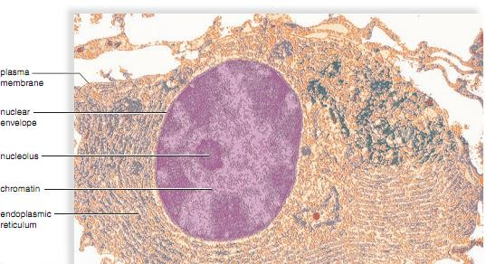

Slide 7
Internal Structure of Eukaryotic Cells
The most prominent organelle within the eukaryotic cell is a nucleus,
a membrane-enclosed structure in which DNA is found. Prokaryotic cells (such as bacterial cells) lack a nucleus . Although the DNA of prokaryotic cells is centrally placed within the cell, it is not surrounded by a membrane.
Eukaryotic cells also possess organelles, each type of which has a specific function
Many organelles are surrounded by a membrane, which keeps the various cellular activities separated from one another.

Slide 8
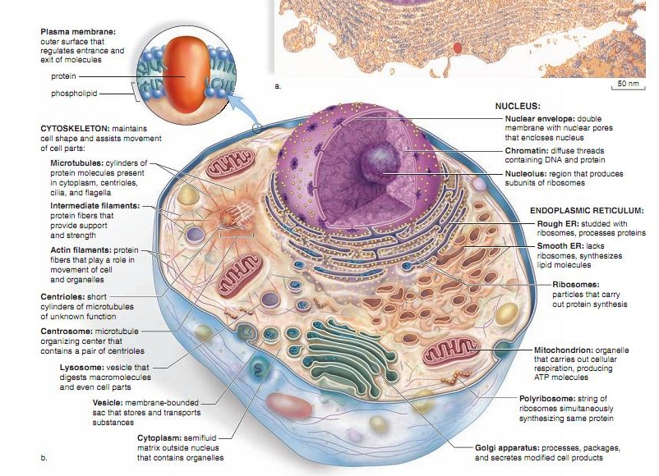
8

Slide 9
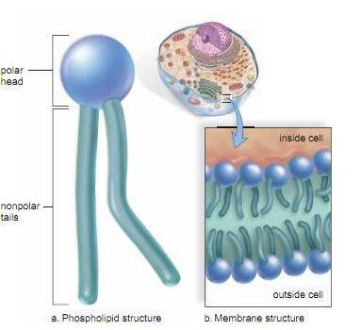
The Plasma Membrane And How Substances Cross It
A human cell, like all cells, is surrounded by an outer plasma membrane
The plasma membrane marks the boundary between the outside and the inside of the cell. The integrity and function of the plasma membrane are necessary to the life of the cell. The plasma membrane is a phospholipid bilayer with attached or embedded proteins.
A phospholipid molecule has a polar head and nonpolar tails
9

Slide 10
When phospholipids are placed in water, they naturally form a spherical bilayer. The polar heads, being charged, are hydrophilic (attracted to water). They position themselves to face toward the watery environment outside and inside the cell.
The nonpolar tails are hydrophobic (not attracted to water). They turn inward toward one another, where there is no water.
At body temperature, the phospholipid bilayer is a liquid. It has the consistency of olive oil.
The proteins are able to change their position by moving laterally. The fluid-mosaic model is a working description of membrane structure.
It states that the protein molecules form a shifting pattern within the fluid phospholipid bilayer. Cholesterol gives sup₁₀ port to the
membrane.

Slide 11
Short chains of sugars are attached to the outer surface of some protein and lipid molecules. These are called glycoproteins and glycolipids, respectively.
These carbohydrate chains, specific to each cell, help mark the cell as belonging to a particular individual. They account for why people have different blood types, for example.
Other glycoproteins have a special shape that allows them to act as a receptor for a chemical messenger, such as a hormone.
Some plasma membrane proteins form channels through which certain substances can enter cells.
Others are either enzymes that catalyze reactions or carriers involved in the passage of molecules through th¹¹ e membrane.

Slide 12
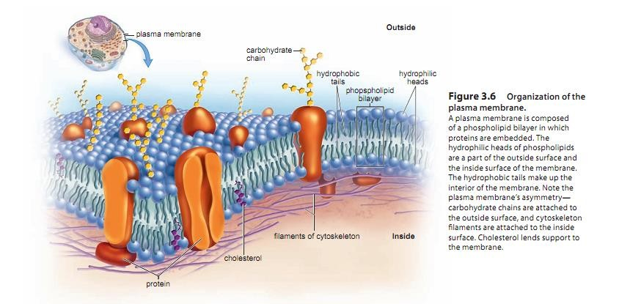

Slide 13
Plasma Membrane Functions
The plasma membrane keeps a cell intact.
It allows only certain molecules and ions to enter and exit the cytoplasm freely. There-fore, the plasma membrane is said to be selectively permeable Small, lipid-soluble molecules, such as oxygen and carbon dioxide, can pass through the membrane easily.
The small size of water molecules allows them to freely cross the membrane by using protein channels called aquaporin.
Ions and large molecules cannot cross the membrane without more direct assistance, which will be discussed ¹³later.

Slide 14
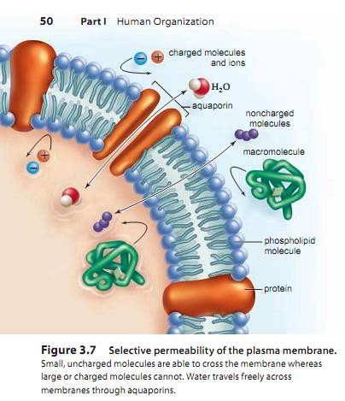

Slide 15
Diffusion
is the random movement of molecules from an area of higher concentration to an area of lower concentration, until they are equally distributed.
Diffusion is a passive way for molecules to enter or exit a cell.
No cellular energy is needed to bring it about.
Certain molecules can freely cross the plasma membrane by diffusion.
When molecules can cross a plasma membrane, which way will they go? The molecules will move in both directions. But the net movement will be from the region of higher concentration to the region of lower concentration, until equilibrium is achieved. At equilibrium, as many molecules of the substance will be entering as leaving the cell
Oxygen diffuses across the plasma membrane, and the net movement is toward the inside of the cell. This is because a cell uses ₁₅oxygen when it produces ATP molecules for energy purposes.

Slide 16
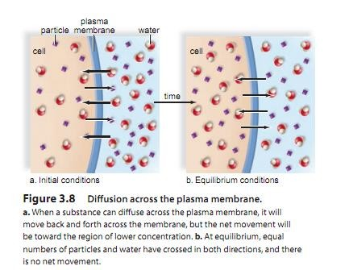
16

Slide 17
Osmosis
Osmosis is the net movement of water across a semipermeable membrane, from an area of higher concentration to an area of lower concentration.
The membrane separates the two areas, and solute is unable to pass through the membrane. Water will tend to flow from the area that has less solute (and therefore more water) to the area with more solute (and therefore less water).
Tonicity refers to the osmotic characteristics of a solution
across a particular membrane, such as a red blood cell membrane.

Slide 18
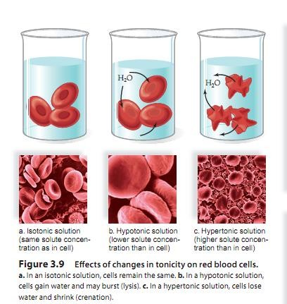
Normally, body fluids are isotonic to cells There is the same concentration of non diffusible solutes and water on both sides of the plasma membrane.
Therefore, cells maintain their normal size and shape. Intravenous solutions given in medical situations are
usually isotonic.

Slide 19
Solutions that cause cells to swell or even to burst due to an intake of water are said to be hypotonic.
A hypotonic solution has a lower concentration of solute and a higher concentration of water than the cells.
If red blood cells are placed in a hypotonic solution, water enters the cells. They swell to bursting Lysis is used to refer to the process of bursting cells. Bursting of red blood cells is termed hemolysis.

Slide 20
Solutions that cause cells to shrink or shrivel due to loss of water are said to be hypertonic.
A hypertonic solution has a higher concentration of solute and a lower concentration of water than do the cells.
If red blood cells are placed in a hypertonic solution, water leaves the cells; they shrink The term crenation refers to red blood cells in this condition.
These changes have occurred due to osmotic pressure. Osmotic pressure controls water movement in our bodies.
For example, in the small and large intestines, osmotic pressure allows us to absorb the water in food and drink.
In the kidneys, osmotic pressure controls water absorption as well.

Slide 21
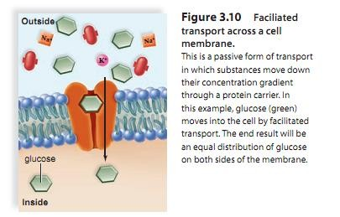
Facilitated Transport Many solutes do not simply diffuse across a plasma membrane.
They are transported by means of protein carriers within the membrane.
During facilitated transport, a molecule is transported across the plasma membrane from the side of higher concentration to the side of lower concentration
This is a passive means of transport because the cell does not need to expend energy to move a substance down its concentration gradient.
Each protein carrier, sometimes called a transporter, binds only to a particular molecule, such as glucose.
Type 2 diabetes results when cells lack a sufficient number o²f¹ glucose transporters.

Slide 22
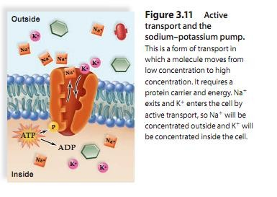
Active Transport
During active transport, a molecule is moving from a lower to higher concentration. One example is the concentration of iodine ions in the cells of the thyroid gland.
In the digestive tract, sugar is completely absorbed from the gut by cells that line the intestines.
In another example, water homeostasis is maintained by the kidneys by the active transport of sodium ions (Na+) by cells lining kidney tubules.
Active transport requires a protein carrier and the use of cellular energy obtained from the breakdown of ATP.

Slide 23
Active Transport
When ATP is broken down, energy is released.
In this case, the energy is used to carry out active transport. Proteins involved in active transport often are called pumps Just as a water pump uses energy to move water against the force of gravity, energy is used to move substances against their concentration gradients. One type of pump active in all cells moves sodium ions (Na+) to the outside and potassium
ions (K+) to the inside of the cell

Slide 24
Endocytosis and Exocytosis
Endocytosis
During endocytosis, a portion of the plasma membrane invaginates inward
, or forms a pouch, to envelop a substance and fluid, Then the membrane pinches off to form an endocytic vesicle inside the cell
Some white blood cells are able to take up pathogens (disease-causing agents) by endocytosis.
Here the process is given a special name: phagocytosis. (“cellular eating”):
Usually, cells take up molecules and fluid, and then the process is called pinocytosis. (“cellular drinking”):
A special form of endocytosis uses a receptor, Binding of ligands to receptors triggers vesicle formation a special form of membrane protein, on the surface of the cell to concentrate specific molecules of interest for endocytosis.

Slide 25
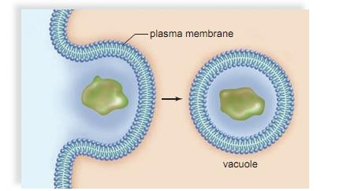
Endocytosis

Slide 26
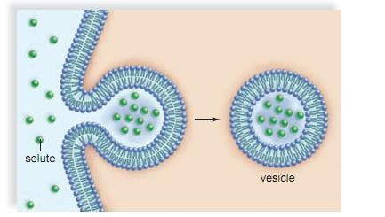
pinocytosis.

Slide 27
A special form of endocytosis uses a receptor, a special form of membrane protein, on the surface of the cell to concentrate specific molecules of interest for endocytosis.
This process is called receptor-mediated endocytosis An inherited form of cardiovascular disease occurs when cells fail to take up a combined lipoprotein and cholesterol molecule from
the blood by receptor-mediated endocytosis.

Slide 28
Receptor-mediated endocytosis is highly specific. Human cells use receptor-mediated endocytosis to take in cholesterol. Some viruses (i.e. HIV virus) enters the cell through receptor-mediated endocytosis Mutations in receptor proteins involved in receptor- mediated endocytosis usually block the entrance of substances meant to be transported by this process (i.e. natural HIV immunity, familial hypercholesterolemia

Slide 29
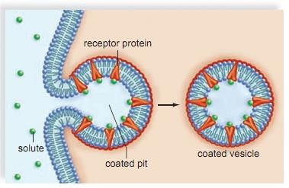
Receptor-mediated endocytosis

Slide 30
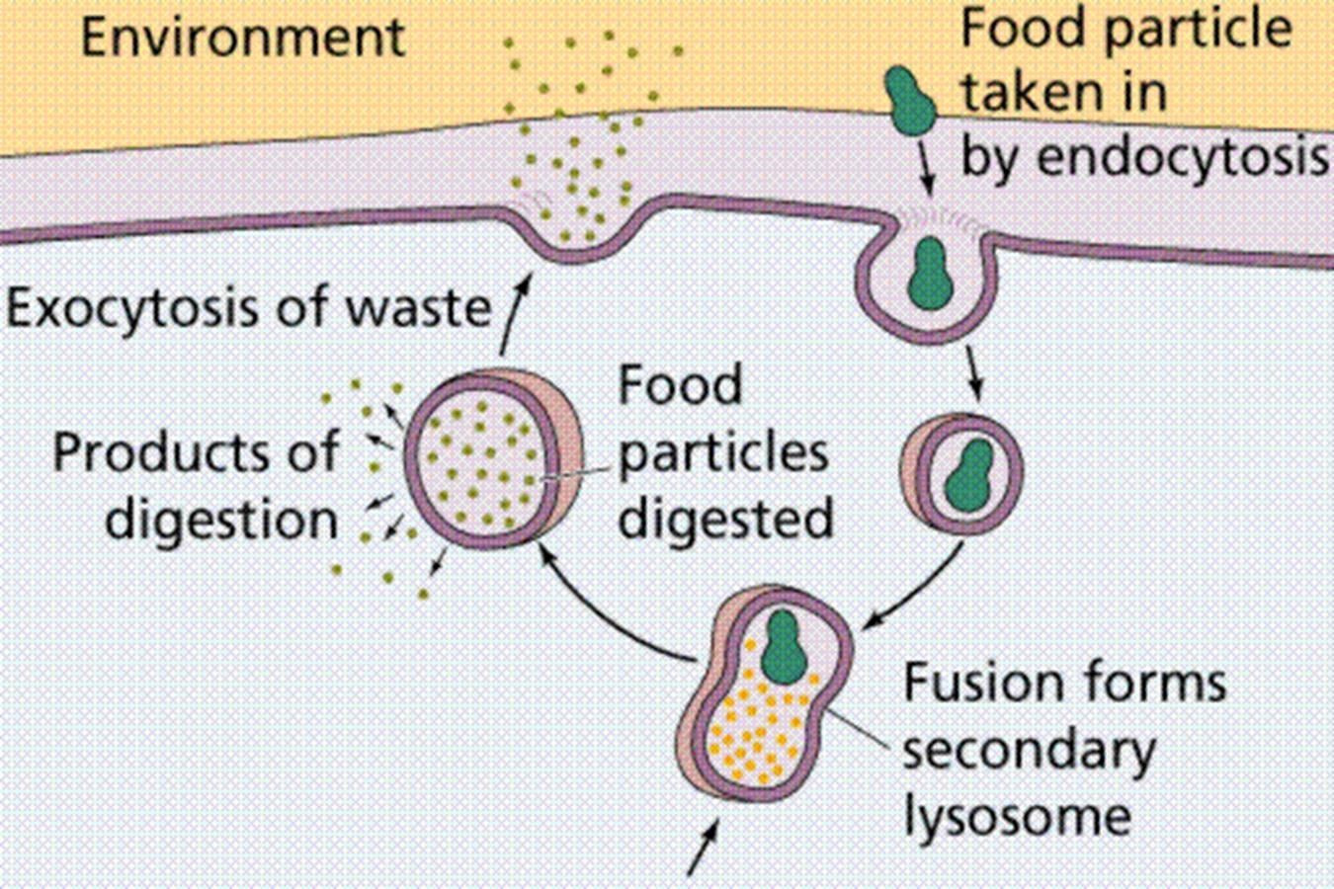
Exocytosis:
a vesicle fuses with the plasma membrane as secretion occurs before finally fusing with the plasma membrane. This is the way that signaling molecules, called neurotransmitters , leave one nerve cell to excite the next nerve cell or a muscle cell.
30

Slide 31
The Nucleus and Endomembrane System
The nucleus and several organelles are involved in the production and processing of proteins.
The endomembrane system is a series of membrane organelles that function in the processing of materials for the cell.

Slide 32
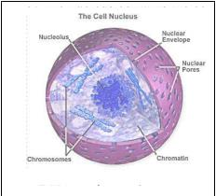
The Nucleus
The nucleus, a prominent structure in cells, stores genetic information
Every cell in the body contains the same genes.
Genes are segments of DNA that contain information for the production of specific proteins.
Each type of cell has certain genes turned on and others turned off.
DNA, with RNA acting as an intermediary, specifies the proteins in a cell.
Proteins have many functions in cells, and they help determine a cell’s specificity.

Slide 33
Chromatin is the combination of DNA molecules and proteins that make up the chromosomes.
Chromatin can coil tightly to form visible chromosomes during meiosis (cell division that forms reproductive cells in humans) and mitosis (cell division that duplicates cells).
Chromatin is immersed in a semifluid medium called the
nucleoplasm.
A difference in pH suggests that nucleoplasm has a different composition from cytoplasm.

Slide 34
Ribosomes
Ribosomes are organelles composed of proteins and rRNA.
Protein synthesis occurs at the ribosomes.
Ribosomes are often attached to the endoplasmic reticulum; but they also may occur free within the cytoplasm, either
singly or in groups called polyribosomes.

Slide 35
The endomembrane system
The endomembrane system consists of
the nuclear envelope,
the endoplasmic reticulum,
the Golgi apparatus,
lysosomes and vesicles (tiny membranous sacs) .
This system classifies the cell so that chemical reactions are restricted to specific regions.
The vesicles transport molecules from one part of the system to another.

Slide 36
The Endoplasmic Reticulum
The endoplasmic reticulum has two portions.
Rough ER is studded with ribosomes on the side of the membrane that faces the cytoplasm.( Here, proteins are synthesized and enter the ER interior, where processing and modification begin .Some of these proteins are fused into membrane, and some are for export.
Smooth ER, continuous with rough ER,does not have attached ribosomes.
Smooth ER synthesizes the phospholipids that occur in membranes and has various other functions, depending on the particular cell.
In the testes,it produces testosterone.
In the liver, it helps detoxify drugs.
The ER forms transport vesicles in which large molecules are transported to other parts of the cell. Often, these³⁶ vesicles are on their way to the plasma membrane or the Golgi apparatus.

Slide 37
The Golgi Apparatus
The Golgi apparatus consists of a stack of slightly curved saccules, whose appearance can be compared to a stack of pancakes.
Here, proteins and lipids received from the ER are modified.
For example, a chain of sugars may be added to them.
This makes them glycoproteins and glycolipids, molecules often found in the plasma membrane.
The vesicles that leave the Golgi apparatus move to other parts of the cell. Some vesicles continue to the plasma membrane , where they discharge their contents.
In all, the Golgi apparatus is involved in processing, packaging, and secretion.

Slide 38
Lysosomes
membranous sacs produced by the Golgi apparatus , contain hydrolytic enzymes.
Lysosomes are found in all cells of the body but are particularly numerous in white blood cells that engulf disease-causing microbes.
When a lysosome fuses with such an endocytic vesicle, its contents are
digested by lysosomal enzymes into simpler subunits that then enter the cytoplasm. In a process called auto digestion,
Some human diseases are caused by the lack of a particular lysosome enzyme.
Tay–Sachs disease occurs when an undigested substance collects in nerve cells,leading to developmental problems and death in early
childhood.

Slide 39
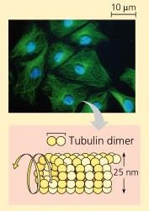
Microtubules
Structure
thickest fibers
constructed of protein, tubulin

Slide 40
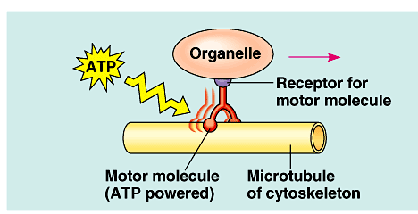
Microtubules
Function
structural support & cell movement move chromosomes during cell division centrioles
tracks that guide motor proteins carrying organelles to their destination
motor proteins: myosin & dynein
motility
cilia flagella

Slide 41
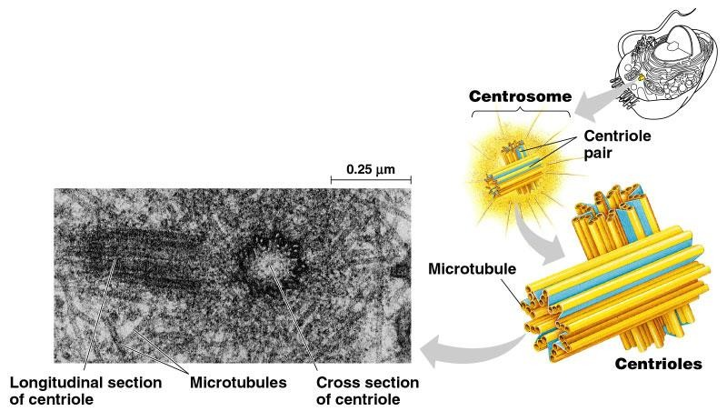
Centrioles
Cell division 
pair of centrioles 
organize microtubules guiding 
chromosomes in cell division

Slide 42
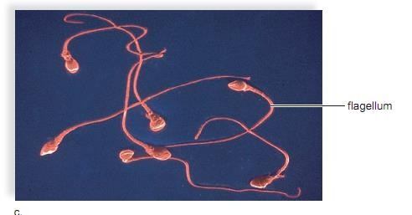
Extensions of eukaryotic cytoskeleton
The ciliated cells that line our respiratory tract sweep debris trapped within mucus back up the throat , This helps keep the lungs clean.
ciliated cells move an egg along the oviduct, where it will be fertilized by a flagellated sperm cell
Cilia = numerous & short (hair-like) Flagella = 1-2/cell & longer (whip-like)
42

Slide 43
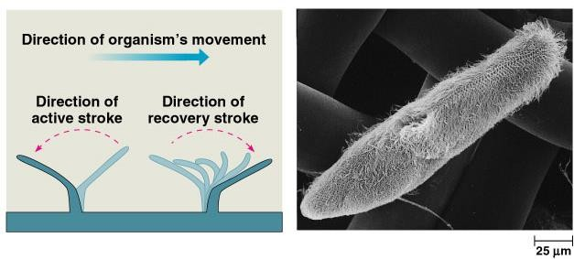

Slide 44
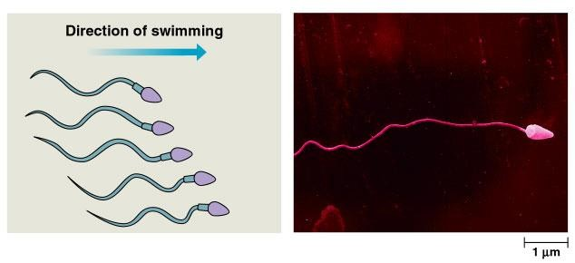
◆ undulatory movement
◆ force generated parallel to flagellum’s axis
44

Slide 45
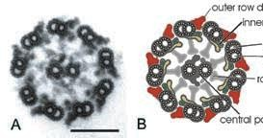
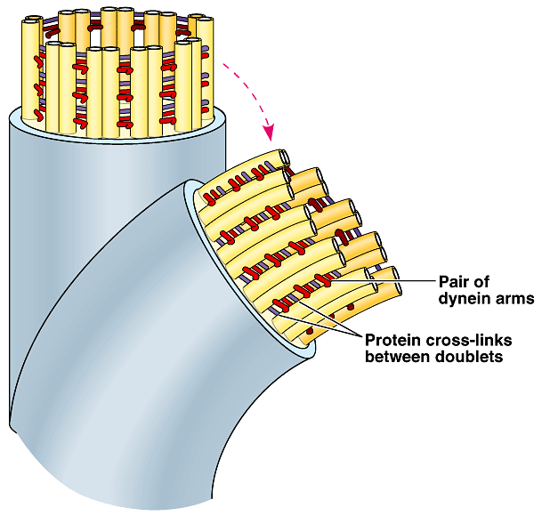
Cilia & Flagella
Structure
remember
9+2!
9 pairs of microtubules around 2 single microtubules in center
requires ATP

Slide 46
Mitochondria and Cellular Metabolism
Mitochondria (sing., mitochondrion) are often called the powerhouses of the cell. Just as a powerhouse burns fuel to produce electricity, the mitochondria convert the chemical energy of glucose products into the chemical energy of ATP molecules. In the process, mitochondria use up oxygen and give off carbon dioxide. Therefore, the process of producing ATP is called cellular respiration.
The structure of mitochondria is appropriate to the task.
The inner membrane is folded to form little shelves called cristae.
These project into the matrix, an inner space filled with a gel-like fluid The matrix of a mitochondrion contains enzymes for breaking down glucose products.
ATP production then occurs at the cristae. Protein complexes that aid in the conversion of energy are located in an assembly-line fashion on these membranous shelves.
Mitochondria are bounded by a double membrane, as a prokaryote would be if taken into a cell by endocytosis.
Even more interesting is the observation that mitochondria have their own genes— and they reproduce themselves!

Slide 47







 | Animal Cell | Plant Cell
Cell wall | Absent | Present (formed of cellulose)
Shape | Round (irregular shape) | Rectangular (fixed shape)
Vacuole | One or more small vacuoles (much smaller than plant cells). | One, large central vacuole taking up 90% of cell volume.
Centrioles | Present in all animal cells | Only present in lower plant forms.
Chloroplast | Animal cells don't have chloroplasts | Plant cells have chloroplasts because they make their own food
Cytoplasm | Present | Present
Endoplasmic Reticulum (Smooth and Rough) | Present | Present
Ribosomes | Present | Present
Mitochondria | Present | Present
Plastids | Absent | Present
Golgi Apparatus | Present | Present
Plasma Membrane | only cell membrane | cell wall and a cell membrane
Microtubules/ Microfilaments | Present | Present
Flagella | May be found in some cells | May be found in some cells
Lysosomes | Lysosomes occur in cytoplasm. | Lysosomes usually not evident.
Nucleus | Present | Present
Cilia | Present | It is very rare

Slide 48
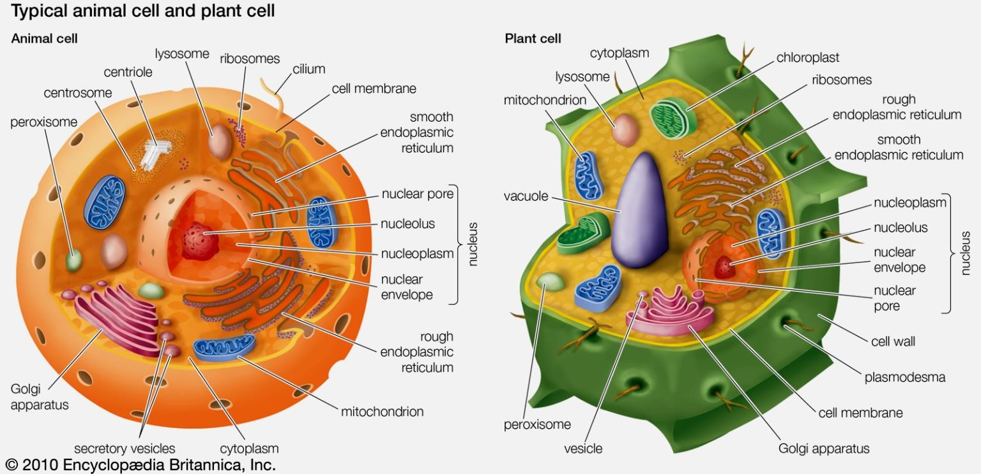
48

Slide 49


