Slide 1
كلية الرشيد الجامعة
قسم تقنيات التحليلات المرضية
Food Nutrition
Their origins and composition
د. حسين الشريف
المحاظرة الخامسة والسادسة

Slide 2
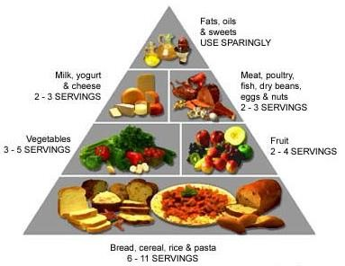
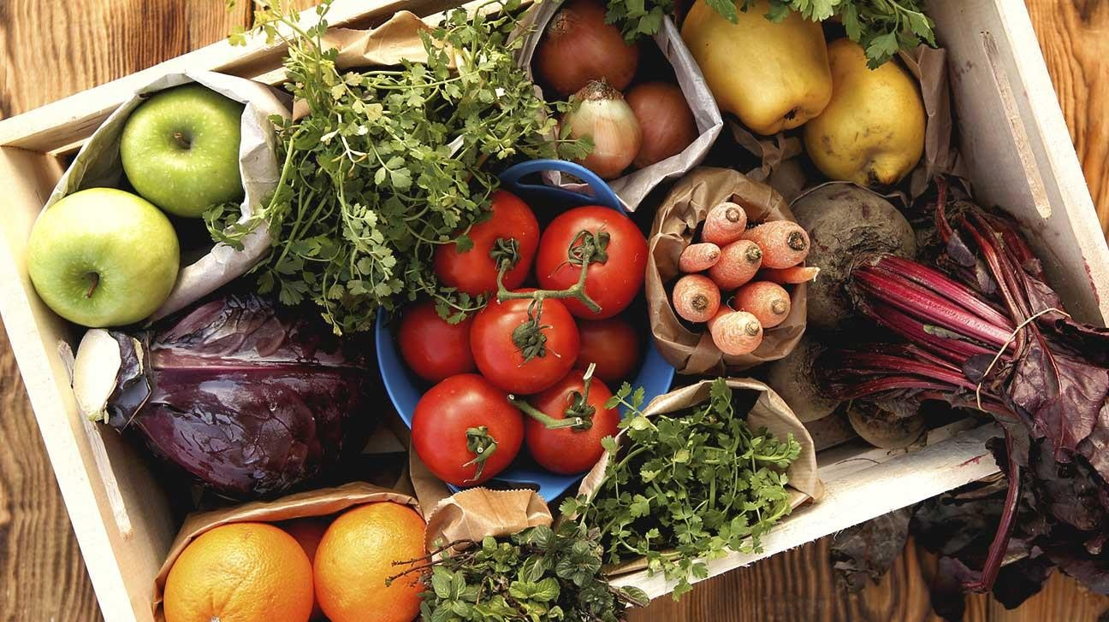
INTRODUCTION TO FOODS, NUTRIENTS AND DIETS
We need firstly to say what we mean by a "food". Food can be solid or liquid, that is they are eaten or drunk. The type of material that is called food will differ from country to country. Not too many of the people reading this book will be accustomed to hors, dog or ants as items of food, but there are acceptable as food will differ from culture to culture and country to country.

Slide 3
These foods have something in common: they all contain nutrients. The nutrients presents in these food are:
Carbohydrates | Mineral elements
Proteins | Vitamins
Fats | Water
It does not matter what food we eat as long as it contains these nutrients. Some of these nutrients are described as essential to our diet because the body cannot make them in sufficient amounts for our needs.In order to survive in good health our daily diet should contain a balanced quantity of these nutrients.

Slide 4
The idea of a balanced diet will be discussed later. The result of consuming an unbalanced diet is malnutrition.
We need the nutrients in our diet in order to be able to:
Build and maintain our body
Supply energy for life processes
Regulate our life processes
We need to eat materials that benefit the body. By eating, we replace these components the components of our diet. By eating, we replace these components as they are used up.

Slide 5
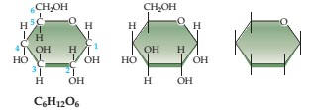
CARBOHYDATES
Carbohydrates are the energy-supplying nutrients, that is when broken down by digestion they release energy. Chemically they are made up from the elements carbon, hydrogen and oxygen, with the hydrogen and oxygen in the ratio 2:1.
Example: Glucose sugar C₆H₁₂O₆
Note the ratio CH₂O
These nutrients are found as sugars and starches in foods such as honey, table sugar, bread, potatoes and rice.

Slide 6
For convenience it possible to group carbohydrates as below:
Monosaccharaides ("simple" sugar)
With five carbons (pentose) – ribose
With six carbons (hexose) – glucose (grape sugar) fructose (fruit sugar)

Slide 7
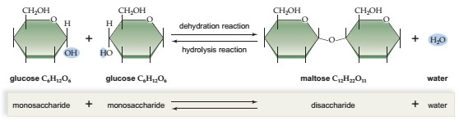
Disaccharides ("double" sugar)
Sucrose – from sugar beet or sugar cane
Maltose – from germinated cereal grains, Lactose – in milk

Slide 8
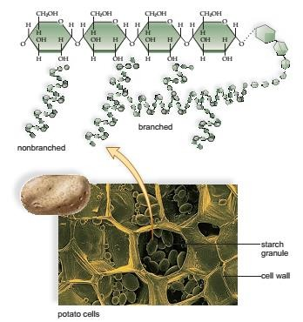
Polysaccharides ("multiple" sugar)
Starch – found in seeds, tubers and roots, Cellulose – found in plant cell walls
Glycogen – ("animal starch") found in liver and muscles.

Slide 9
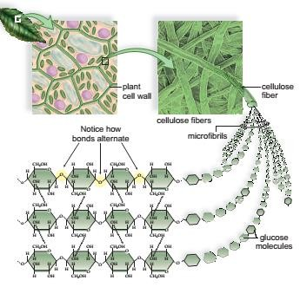
MONOSACCHARIDES AND DISACCHARIDES
Sugar are found in plants. Plants transport their carbohydrates around from tissue to tissue dissolved in water (sap), and the juices of plants contain such sugars as glucose, fructose and sucrose. Carbohydrates are stored in the plant as insoluble starch.

Slide 10
Sugar beet is the most common source of sucrose in the UK.
Peas and sweet corn taste sweet because of the presence of sugars in the immature seeds. As the seeds mature the sugars change into starch.
Beets and carrots also taste sweet because of the presence of sugar.
Bananas become sweeter as they ripen because starch is converted to sugar.

Slide 11
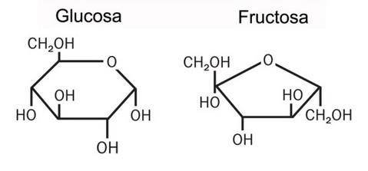
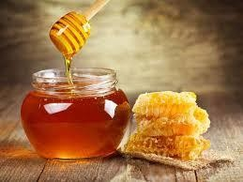
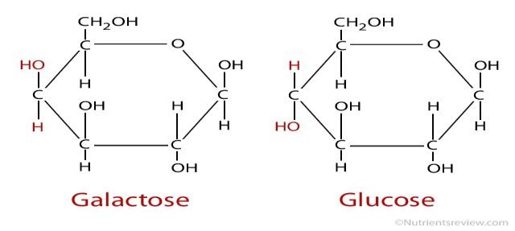
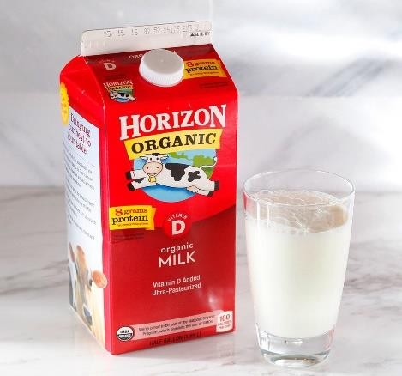
Honey contains both glucose and fructose in about equal quantities and is not a suitable sugar replacement for those seeking a low-calorie or low-sugar diet. Sprouting or germinating cercal grains contain a break down product of starch called maltose sugar. It is a double sugar made up from two molecules of glucose.
Milk contains the sugar lactose. This is a less soluble and less sweet sugar that is less easily galactose and glucose. Not everybody can handle lactose in their diet: they have a lactose intolerance because they lack Or are low in the enzyme lactase .This applies to large numbers of people on the African continent ,and those elsewhere of African ancestry.

Slide 12
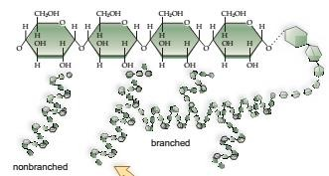
Sweetness is not a characteristic of all sugars: some sugars have no sweet taste and some non-sugars are very sweet.
POLYSACCHARIDES
Polysaccharides are not water-soluble. They include important nutrients such as starch, cellulose and glycogen.
Seeds, potato tubers and roots store starch as an energy reserve. It is made up from long chains of glucose molecules, with from 300 to many thousands of sugar molecules in each starch molecule. A starch molecule may be a long unbranched chain called an amylose area branched chain called amylopectin. In nature starch is' found within granules, which need to be ruptured first before the starch can be easily digested.

Slide 13
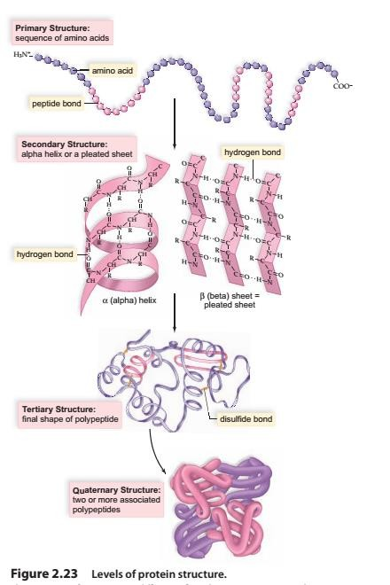
PROTEINS
Proteins are the tissue builders and tissue repairers. They also supply energy if carbohydrates and fats are in short supply, and aid in regulating our tissue water balance. All our important body defenses (antibodies) and all our enzymes are proteins. Chemically proteins are made up of carbon, hydrogen, oxygen and nitrogen. Many proteins also contain the elements Sulphur and phosphorus.

Slide 14
PROTEINS
They are complex organic molecules that are basically chains of amino acids joined by peptide links. One protein differs from another in the types of amino acids to be found the chain, the order in which they are joined up, and the way the chain branches and folds up into a three- dimensional structure

Slide 15
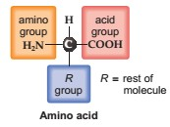
Amino Acids
Subunits of Proteins, Proteins are macromolecules with amino acid subunits.
The central carbon atom in an amino acid bonds to a hydrogen atom and also to three other groups of atoms.
The name amino acidis appropriate because one of these groups is an —NH2(amino group) and another is a —COOH (carboxyl group, an acid). The third group is the R group for an amino acid.

Slide 16
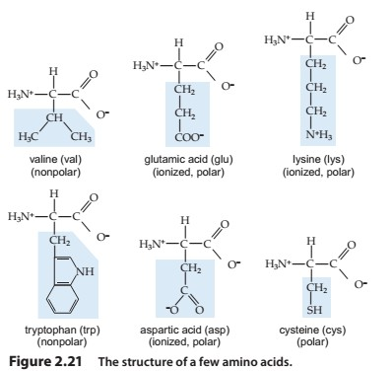
There are 22 amino acids from which a protein molecule can be built, but not all of them are essential to our diet, essential amino acids are those that must be in our diet because we are unable to manufacture them in the body .There are at least eight such essential amino acids. Some proteins, called complete proteins, contain all the essential amino acids and are of high biological value as foods. Others are lacking in one or more essential amino acids and are called incomplete proteins.

Slide 17
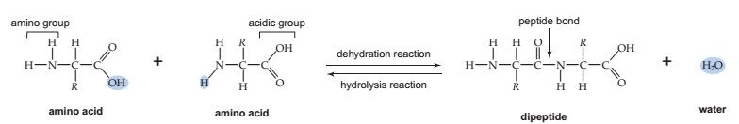

Peptides
two amino acids join by a dehydration reaction between the carboxyl group of one and the amino group of another. The covalent bond between two amino acids is called a peptide bond. When three or more amino acids are linked by peptide bonds, the chain that results is called a polypeptide. The atoms associated with the peptide bond share the electrons unevenly because oxygen attracts electrons more than nitrogen. Therefore, the hydrogen attached to the nitrogen has a slightly positive charge(δ+), whereas the oxygen has a slightly negative charge (δ−)

Slide 18
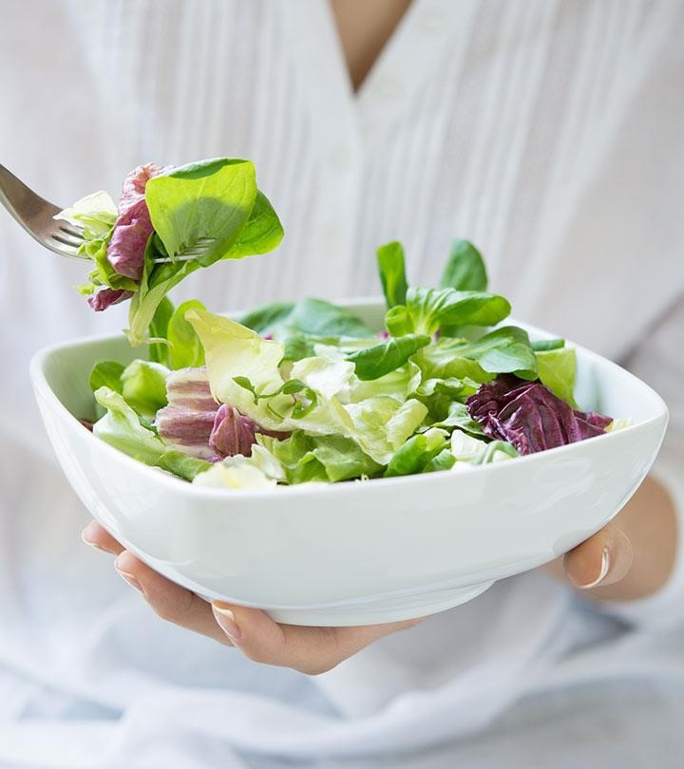
All animal proteins (except gelatin) are complete proteins. All vegetable proteins (except soya bean) are incomplete proteins. This creates a potential problem for those people who never eat food of animal origin (vegetarians), for they must plan their diets and food supplements very carefully if they are not to suite; from malnutrition.

Slide 19
PROTEINS IN OUR FOOD
It can be seen that meats are the best source of protein but that legumes and nuts are quits good. There are occasions when greater amounts of protein need to be eaten, such as during growth.Other times when the protein component of the diet needs to be increased are:
During pregnancy
During lactation
During convalescence
During an infectious disease and fever
in cases of over-active thyroid gland
For those suffering burns

Slide 20
THE USES OF PROTEINS
Proteins are digested by the intestinal enzymes called proteases.
This digestion produces amino acids that are absorbed into the
blood stream and distributed around the body for use as outlined below:
New tissues are built, Old tissues are repaired.
Energy is produced (1 g of protein yields 4 kilocalories). This is an expensive way to produce energy, though, and is only used if we are short of carbohydrates and fats.
The water balance of the body is maintained. This water balance can be upset if there is not enough protein in the blood. The water will accumulate in the tissues causing swelling or edema .This can be seen in cases of kwashiorkor or protein starvation.
Antibodies are made, these proteins help us resist disease.
Many secretion of our bodies, including all enzymes and some hormones, are built up from amino acids.

Slide 21
FATS
Fats are energy-yielding foods, when digested they release. about twice as much energy as carbohydrates or proteins.
100 g of fat yields 900 kcal.
100 g of carbohydrate yields 400 kcal 100 g of protein yields 400 kcal
In industrialized Europe and North America fat makes up about 15-20% by weight of our food and yields about 40% of our calories. In those countries that consume lower amounts of fat (25-30 %of diet calories) there is also lower incidence of heart disease .Does this men that fatty foods cause heart disease? It is as easy as that. We shall discuss this later.

Slide 22
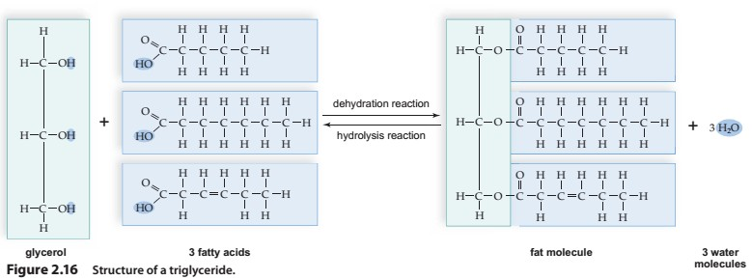
Chemically fats are made up of carbon, hydrogen and oxygen but not in the same proportion as they are in carbohydrates (CH₂O). In fats there is more carbon and hydrogen and relatively less oxygen.
Fats are essential to our health and are familiar to everybody because we eat them at most meals in one form or another. Fats are lipids, that is they belong to a wide group of chemicals that include waxes and cholesterol.
Fats are also described as triglycerides, because they are made up from three molecules of glycerol combined with three fatty acids, as shown in

Slide 23
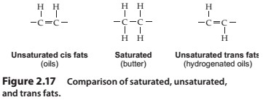
The fats that we eat may be liquid, semi-solid or solid (e.g. butter, margarine, lard, beef fat, vegetable oils and salad oils). These fats are different because of the fatty acids that they
contain. The animal fats and coconut oil are solid at room temperature and are described as saturated. This means that they contain fatty acids of the saturated type, such as stearic acid and palmitic acids.
The plant or vegetable fats and fish oils are liquid at room temperature and are described as unsaturated. This means that they contain fatty acids of the unsaturated type, such as linoleic acid and oleic acid.

Slide 24
Saturated fatty acids | Unsaturated fatty acids
Solid at room temperature palmitic acid and stearic acid and stearic acid animal fats and coconut oil; Contain high percentage of saturated fatty acids | Liquid at room temperature oleic acid and linoleic acid liquid vegetable oils and fish Oil; contain unsaturated fatty acids

Slide 25
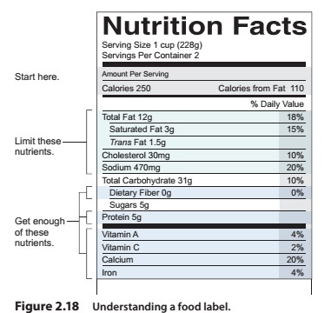
THE USES OF FATS
Before fats can be digested by, fat enzymes (lipases) they must be dispersed as fine particles. This is called emulsification and takes place when we secrete bile juice into the duodenum. Fats are digested much more slowly than other foods, particularly in infants and older people
Fats and fat-containing foods have a wide range of uses in the human body.

Slide 26



