Slide 1
T H E C H A R A C T E R I S T I C S
O F L I F E
قسم تقنيات التحليلات المرضية
المحاظرة الثالثة و الرابعة

Slide 2
Characteristics of living organisms
In order to identify living organisms, scientists listed 7 characteristics which all living
organisms have:-
Nutrition: taking in nutrients which are organic substance and mineral, containing raw materials and energy for live and tissue repair, absorbing and assimilating them.
Excretion: removal from organisms of toxic materials, the waste products of metabolism and substances in excess.
Respiration: chemical reactions that break down nutrient molecules in living cells to release energy.
Sensitivity: the ability to detect or sense changes in the environment and to make responses.
Reproduction: progresses that make of the same kind of organism.
Growth: the permanent increase in size and dry mass by an increase in number of cells, cell size, or both.
Movement:

Slide 3
MEDICAL BIOLOGY
The science of biology is the study of living organisms and their environments.
Medicine: is the science or practice of the diagnosis, treatment, and prevention of disease.
It encompasses a variety of health care practices evolved to maintain and restore health by the prevention and treatment of illness.

Slide 4
BASIC CHARACTERISTICS OF LIVING THINGS
(1) are organized,
(2) acquire materials and energy,
(3) reproduce,
(4) grow and develop,
(5) are homeostatic,
(6) respond to stimuli, and
(7) have an evolutionary history.

Slide 5
Living Things Are Organized.
A tissue is a group of similar cells that perform a particular function.
Several types of tissues make up an organ
Organ belongs to an organ system
Human body composed of several organ systems

Slide 6
Individual lives in population (community).
The community of populations interacts with the physical environment to form an ecosystem.
All the Earth’s ecosystems make up the biosphere.
Living Things Acquire Materials and Energy
Food..

Slide 7
Metabolism
Photosynthesis
Life Is Homeostatic:
The ability of a cell or an organism to maintain an internal environment that operates under specific conditions is called homeostasis.

Slide 8
LIVING THINGS RESPOND TO STIMULI
Response to external stimuli
Living things respond to external stimuli, often by moving toward or away from a stimulus
Variety of mechanisms to move.
Movement in humans and other animals is dependent upon their nervous and musculoskeletal systems

Slide 9
LIVING THINGS REPRODUCE AND DEVELOP
Reproduction is a fundamental characteristic of life.
All living things have parents.When living things reproduce, they create a copy of themselves and ensure the continuance of their own kind
fertilization of the egg by a sperm cell Zygot

Slide 10
GROWTH AND DEVELOPMENT
Growth, recognized by an increase in size and often the number of cells, is a part of development.
In humans, development includes all the changes that occur from the time the egg is fertilized until death;
Development also includes the repair that takes place following an injury
DNA contains the hereditary information that directs not only the structure of each cell but also its function.
The information in the DNA is contained within
genes, short sequences of hereditary material that specify the instructions for a specific trait

Slide 11
LIVING THINGS
ADAPT AND EVOLVE
Evolution is the process by which a species changes through time
Evolution, which has been going on since the origin of life and which will continue as long as life exists, explains both the unity and the diversity of life.
Organisms are diverse because they are adapted to different ways of life

Slide 12
3 DOMAINS
Two of these domains, domain Bacteria and domain Archaea, contain prokaryotes.
one-celled organisms that lack a nucleus Eukarya, are classified as being members of one of four kingdoms
plants, fungi, animals, and protists.
Invertebrates,Vertebrates

Slide 13
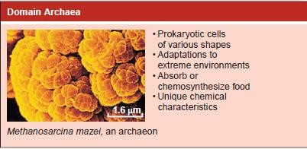

Slide 14
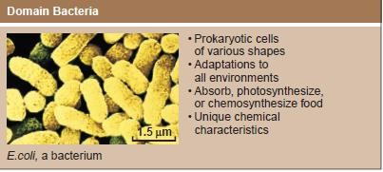

Slide 15
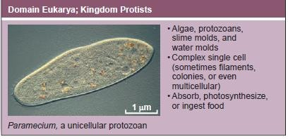

Slide 16
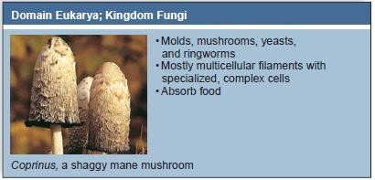

Slide 17
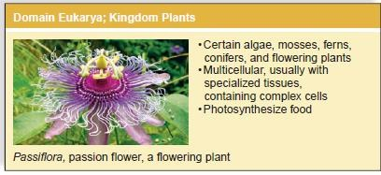

Slide 18
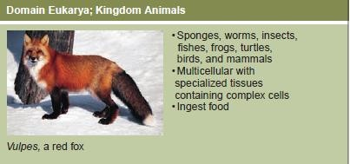

Slide 19
Human beings are most closely related to apes.We
are distinguished from apes by our
highly developed brains,
completely upright stance,
creative language,
ability to use a wide variety of tools.

Slide 20
THANK YOU

