Slide 1
كلية الرشيد الجامعة
قسم تقنيات التحليلات المرضية
The science of Biology
د. حسين الشريف
المحاظرة الاولى والثانيه

Slide 2
The science of Biology
The term biology
What is the term biology mean?
The term biology consist of two wards:-
Bio: - life in Latin language
Logy: - science = study in Latin language Define the term biology?
Biology :-is the science which is dealing with the knowledge about the life of living organisms.
Notice the following schematic of general biology

Slide 3






















General Biology
Some sub-division of biology
General Zoology
General Botany
Animals
Plants
Classification sciences Taxonomy of animal
Essential sciences other basic sciences
Classification sciences Taxonomy of plants
Essential sciences other basic sciences
Home work :-
Give ten examples for the classification and essential sciences

Slide 4

Define the human biology ?
Human biology is the science which is dealing with all studies about the human life .
Define the medical biology ?
It’s a biology science from medical point of view. Why we study biology?
We study biology for many reasons .at this study we can know a good knowledge about animals , plant . medicine and health sciences as a branches from the general biology , food and agriculture , bacteria and viruses as a disease causing with another parasites and disease vector organisms.

Slide 5
Home works:-Tray to find any knowledge about the following-:
Biology and industries.
Biology and the fresh waters.
Biology and the marine waters.
Biology and the ecology (environment).
Biology and the weather.
Biology and genetic.
Biology and the sanitary.
Biology and the wild life.
Biology and the economics. 10.Biology and the veterinary.

Slide 6
The kingdom of living things:-
Biologists in the first strong gives us four kingdoms, which we can call the animal kingdom, the plant kingdom, monera kingdom, and Protista kingdom, each one of these kingdoms are differ from the others by some distinguished characters.

Slide 7

Classification of organisms
Classification is a man make system for the orderly storage and retrieval of things or bits of information about them.
In biology the different kinds of organism run into millions. before we can refer to them each has to have a name and preferably an allotted place in classification system which shows its relationship with other organisms. Naming and classification provide
a terminology essential in the exchange of knowledge and ideas in research and teaching. The terminology of classification is part of the language of the science of biology. The Linnaean hierarchy has thus been to the give the following seven obligatory categories into which in modern taxonomic practice all animals must be classified

Slide 8







Kingdome
phylum
class
order
family
Genus
spices
The kingdom of life
Since 1969 the scientist Whittaker suggested system of five kingdoms as kingdom of life. He put the kingdom Monera as a first evolutional category, followed by kingdom Protista and completed by kingdoms Fungi, plant and Animalia see the following draw.

Slide 9












LIFE
K. Animalia
K. Monera
K. Protista
K. Fungi
K. plant

Slide 10
The concept of kingdom of life was based on nature and structure of the cell type of the organism. He divided all of unicellular organisms into cell type of the organism into two kingdoms, the monera with single cell and prokaryote, the Protista with a true nucleus (Euocaryote). All other organisms that are multicellular and without any metabolic pigments will be as Fungi Kingdom. All the multicellular organism which they have a metabolic pigment will be plant kingdom. All multicellular organisms which they have a foana characteristic will as Animalea kingdom.

Slide 11
The main characters of the five kingdom
1. Kingdom of monera Living organism in which
The body is unicellular and prokaryotes.
The nuclear matter is a chromatin substance and it's distributed in the cytoplasm as a masses of genes called the bacterial chromosomes.
It have a cell wall differ from the plant cells on its structure, it's mostly composed from multi saccharide and semi – cellulose. In addition of slime matters. This characters are belonged to only Bacteria and Blue – green Alge (Cyanophyta).
These type of algae have enable to fix the atmospheric Nitrogen into a nitrogenous substances to fertilize the soil.

Slide 12
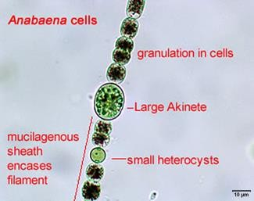
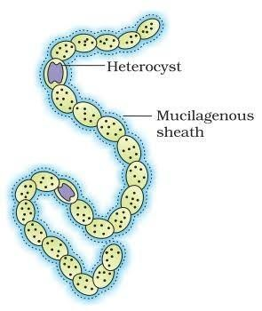
Nostoc cells

Slide 13
The five kingdoms schemes of classification:-
The scientist Pommerville, 2004 describe the universal ancestor for the all living organisms in two lines.
active line (eutrophic organisms)
Universal ancestor
Inactive line (food depending organisms)

Slide 14
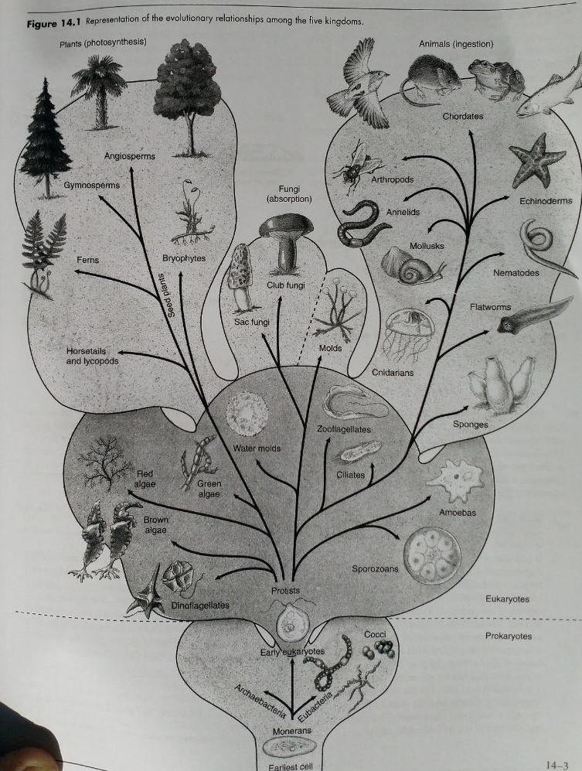
Tree of life : universal ancestor

Slide 15
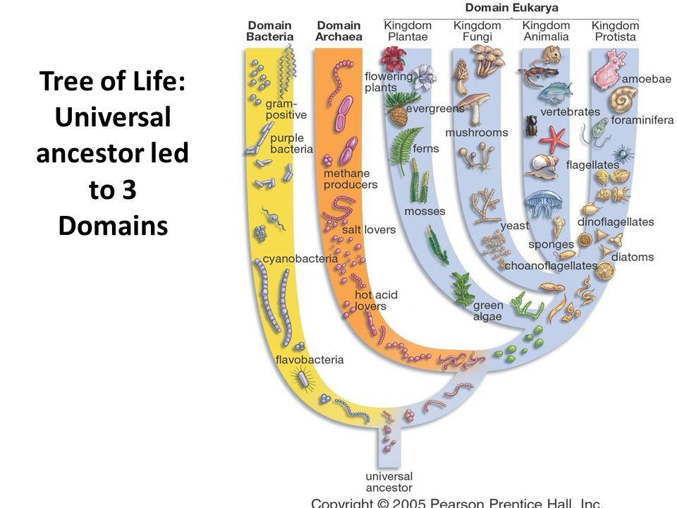

Slide 16

Thank you

